Slide 1
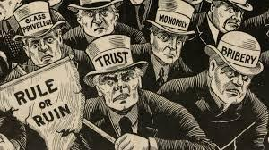
The United States 1870 – 1900
u3a American History
18th May 2021

Slide 2
Features of America by 1870
The 14th Amendment is ratified in 1868 by Congress (Attachment A)
Rise of Radical Republicans and country dealing with one constitutional crisis to the next.
President Andrew Johnson is first president to be impeached though this does not pass the Senate failing by one vote (on Tenure of Office Act *); fails to win nomination for second term.
Ulysses S. Grant becomes President 1869; support for Reconstructions declines
Significant involvement of black Americans in the political process, nearly all support Grant
800 men served in state legislatures
A black man was briefly governor of Louisiana
South Carolina was viewed as being under “Negro rule”
Women’s rights movement (education, own property) becomes women’s suffrage movement that narrows and intensifies; women go to polls to vote but are arrested when trying to cast ballot.
Efforts to suppress black voters through Black Codes and terrorism dramatically increase
[* Johnson tries to remove E Stanton, Secretary of War, radical republican and Lincoln appointee]

Slide 3
Features of America by 1870
Chinese immigration according to 1860 federal census: 34,935
70% (24,282) of the Chinese worked in mines
Initially in California then spread throughout the West and Northwest
Boise, Idaho – by 1865, Chinese accounted for a third of all settlers and 60% of its miners
By 1870, Chinese immigrants and children accounted for 9% of the population of California and 25% of the state’s wage earners.
Restrictions on Chinese increase, despite 1868 Treaty with China that agreed Chinese would be treated like citizens (issues of defining citizenship
During the same period, southern states (mainly Democratic) suffer devastation due to the Civil War and falling prices of commodities that were the main source of income.
In 1868, Southern Democrats launch the New Departure - a political strategy to distance itself from its pro-slavery and Copperhead* history in an effort to broaden its political base, and focus more on economic issues [*Democrats who supported peace with the Confederates].
Despite Congress passing the Force Act of 1870 and the Klan Act of 1871 making it illegal to interfere with suffrage, Klan only intensified its efforts to take back the South. (the Redeemers)
Reconstructions is seen to fail – sealed by Rutherfraud Hayes Compromise of 1877

Slide 4
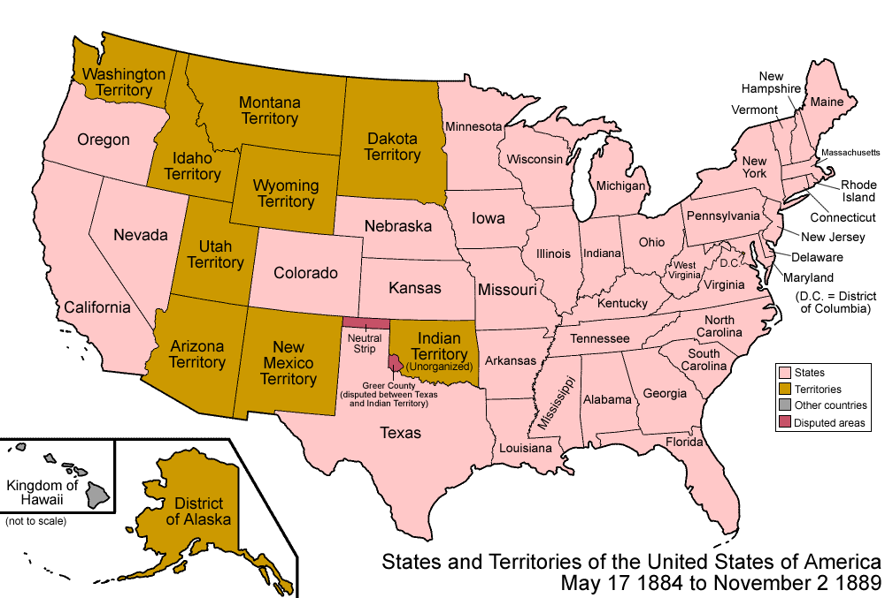

Slide 5
America Advances – Industry & Technology…
Expands in heavy industry – e.g. factories, railroads, mining
1869 First Transcontinental Railroad opens the far-west mining and ranching regions
Travel time dramatically reduced – NY to SF now 6 days rather than 6 months
Isolated areas become linked to larger markets giving rise to commercial farming, ranching and mining
Investors in London and Paris pour money into the railroad through the Wall Street financial markets
By 1900, economic concentration is found in a few large corporations – called “Trusts” that dominate in steel, oil, sugar, meat and farm machinery:
Vertical integration allowed control of all aspects of production including access to raw materials.
Some monopolies (e.g. Standard Oil) prevented competition especially by controlling prices.
Industry becomes increasingly mechanised –
Worker efficiency improvements with stop watch to eliminate wasted efforts;
Simple and repetitive tasks done by unskilled workers.
Machine shops increase with skilled workers and engineers
Development of Engineering colleges, management techniques, career paths –esp in Railroads

Slide 6
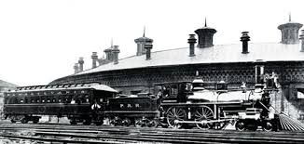
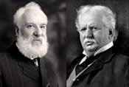
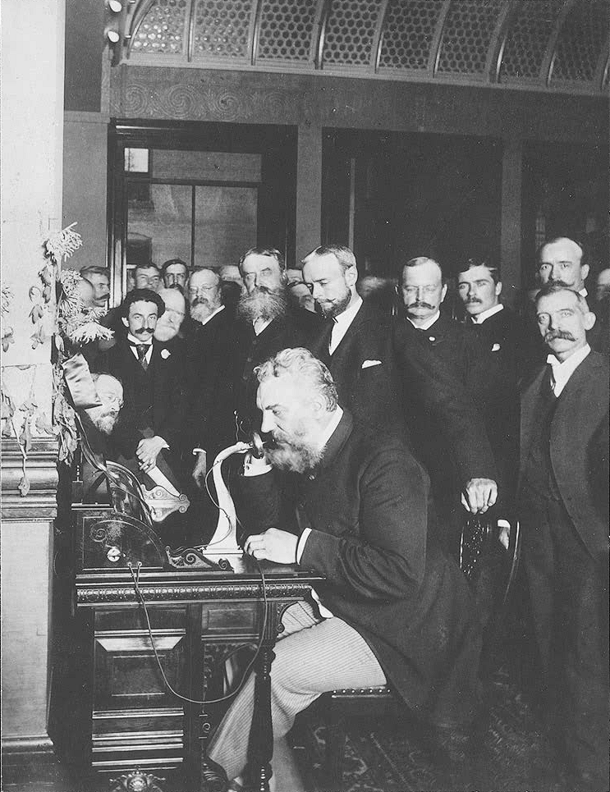
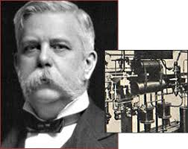
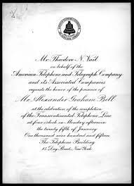
America Advances – Industry & Technology
The US becomes the world leader in applied technology: from 1860 to 1890, 500,000 patents were issued for new inventions (10 times the numbers issued in the previous 70 years.

Slide 7
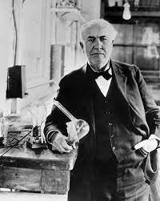
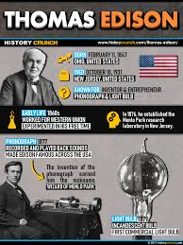
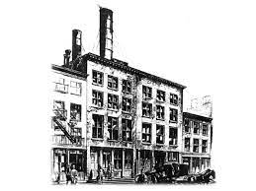
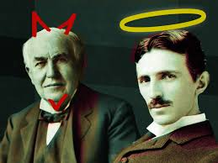
More than a Light Bulb
The famous inventor’s first brainchild was for a device that recorded legislative votes. That was just the start of a career in which he would obtain 1,093 U.S. patents, in addition to another 500 to 600 applications that he either didn’t finish or were rejected. But Edison’s greatest invention may have been developing a new process for coming up with inventions.
Menlo Park New Jersey – pioneered corporate research and development
In 1882, just three years after he had almost literally shocked the world with his electric light bulb, Thomas Edison opened his Pearl Street Station, the first commercial electrical distribution plant in the United States. By 1884 it was already servicing over 500 homes. Also energy provided street lights and electric street cars.

Slide 8
How the Railroads Transformed America
Provided a highly efficient network for shipping freight and passengers across a large national network – almost the size of Europe
The network was integrated with no internal barriers or tariffs, and a common language, financial system and legal system
Railroad financing provided the basis for the expansion of the non-governmental financial system – rail far more expensive than factories.
By 1860, Railroad stocks & bonds = $1.8 billion; by 1897 = $ 10.6 billion(total national debt of $1.2 billion)
Funding came from financiers in the Northeast and Europe, especially Britain; about 10% came from government particularly in the form of land grants.(British investment in Rail worldwide though most in United States – total by 1914 -$3 billion –liquidated in the following years to pay for war supplies).
By 1860, New York was the dominant financial Market
Freedom to travel created a greater sense of national identity and a reduction in regional cultural diversity (Gary Cross & Rick Szostak)
A love –hate relationship –monopolies had too much pricing power – states impose maximums

Slide 9
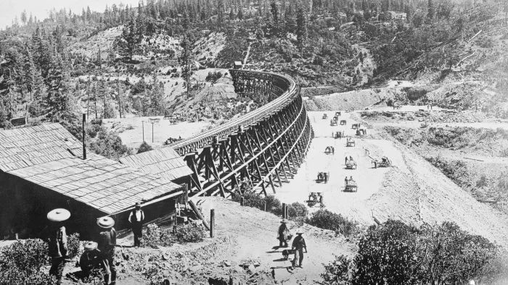
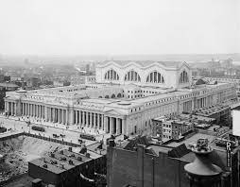
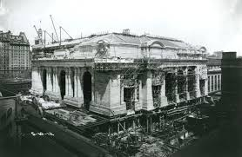
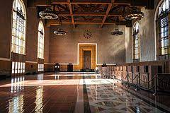
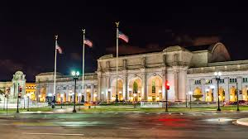
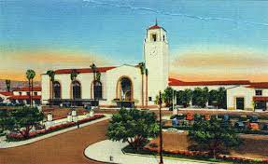

Slide 10
America’s Economy Booms …
During the 1870s and 1880s, US Economy rose at its fastest rate in history with rapid increases in real wages, wealth, GDP and capital formation; for example between 1865 and 1898:
Real wages (1860-1890) rose from by 60% with ever increasing labor force .
The Corporation becomes the dominant form of business organisation
A scientific management revolution transforms business operations
By the beginning of the 20th century, US GDP and industrial production led the world.
OUTPUT | PERCENTAGE INCREASE |  | Annual Avg Wage $ per industrial worker* | Avg Annual $ incomes of all American non-farm employees
WHEAT | 256 |  | 1880 -380 | 1870 - 375
CORN | 222 |  | 1890 - 564 | 1880 - 395
COAL | 800 |  |  | 1890 – 519
MILES OF RAIL ROAD TRACK | 567 |  | * men, women & children | - 573 (total 53% in 30 yrs)

Slide 11
America’s Economy Booms …for some more than others…
Wealthy industrials and financiers dominated and gained huge fortunes:
Sometimes known as robber barons who gained their fortune as the expense of the working class
For others, admired as Captains of Industry who also built the non-profit sector through philanthropy, e.g. Carnegie (90%), Rockefeller (~50%) – endowed thousands of colleges, hospitals, museums, schools, libraries and charities
However, many followed Social Darwinism and laissez-faire capitalism.
Skilled workers – in industry benefited from rising wages and improved standard of living
E.g. Standard of living in Pittsburgh was between 50% to 100% higher than those living in Birmingham, England. (Catlin) (accounting for 65% higher cost of living in the US)
Natural resources ad virgin land – safety value for poorer workers drove wages higher
Perceived higher wages led to steady flow of skilled workers from Britain
Unskilled workers did not benefit from any higher stand of living
Generally earned (if employed) less than $800 a year (60 hour weeks)
Unskilled workers remained in poverty and relied on factory work
Wage labour was widely condemned as wage slavery

Slide 12
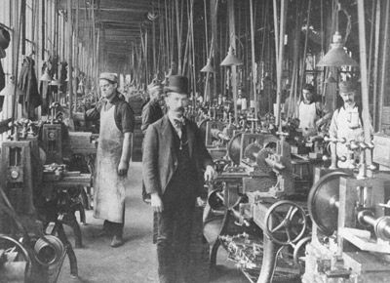
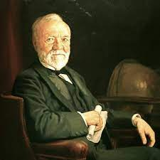
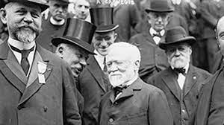
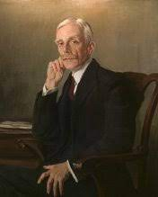
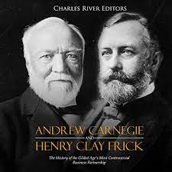
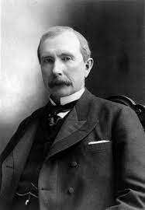
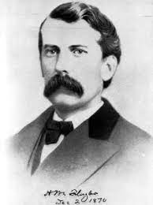
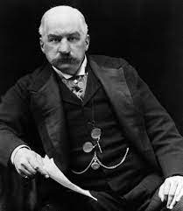
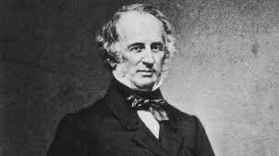
Andrew Mellon
J.P. Morgan
J.D.Rockefeller
Henry Flagler
Cornlius Vanderbilt

Slide 13
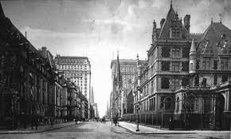
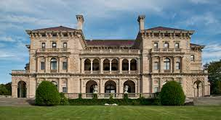
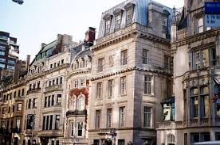
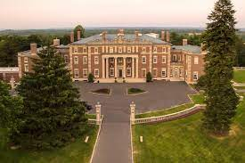
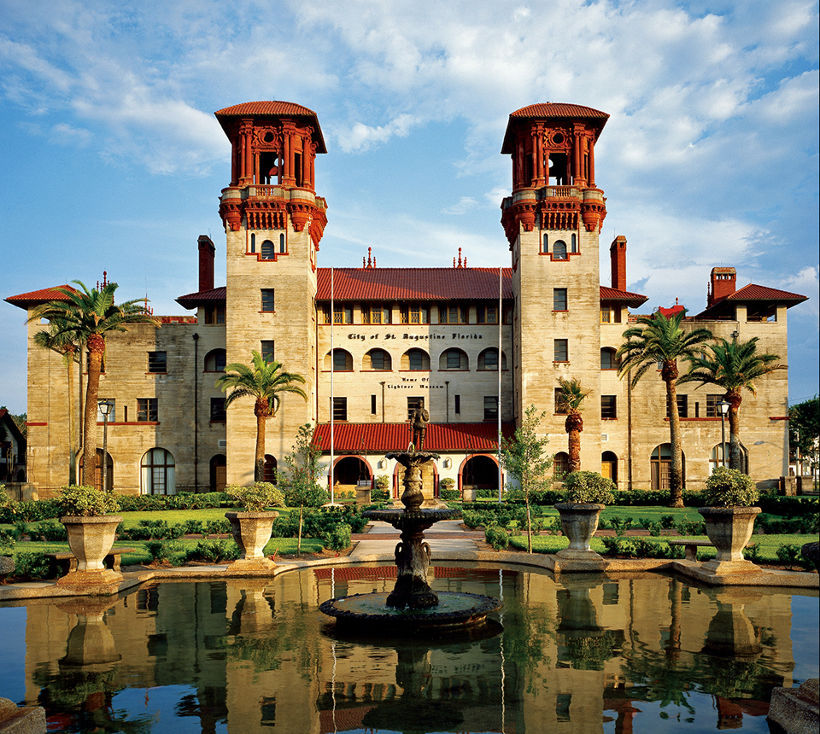
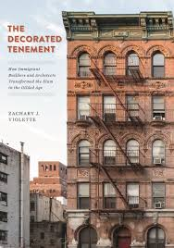
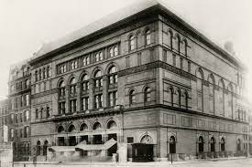

Slide 14
…The Emerging Boom Economy is Marked by Instability
Rampant land speculation – Congress grants more than 100 million acres of public land to the railroad companies:
Major Native Indians resettlements and false promises lead to increased fighting.
Financial disaster strikes in 1873 with a nation-wide depression – the worst since 1837:
100 Banks and 20,000 businesses fail
Grain prices fall, eg. Corn was 45 cents per bush in 1870 and 10 cents in 1889
Again America faces another economic depression in 1893:
Within months, 8000 businesses, 156 railroads and 400 banks collapse
1 in 5 Americans lost their jobs
Non- Indians Living West of the Missouri River
1870 | 2 million
1890 | 10 million

Slide 15
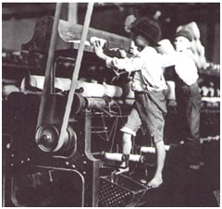
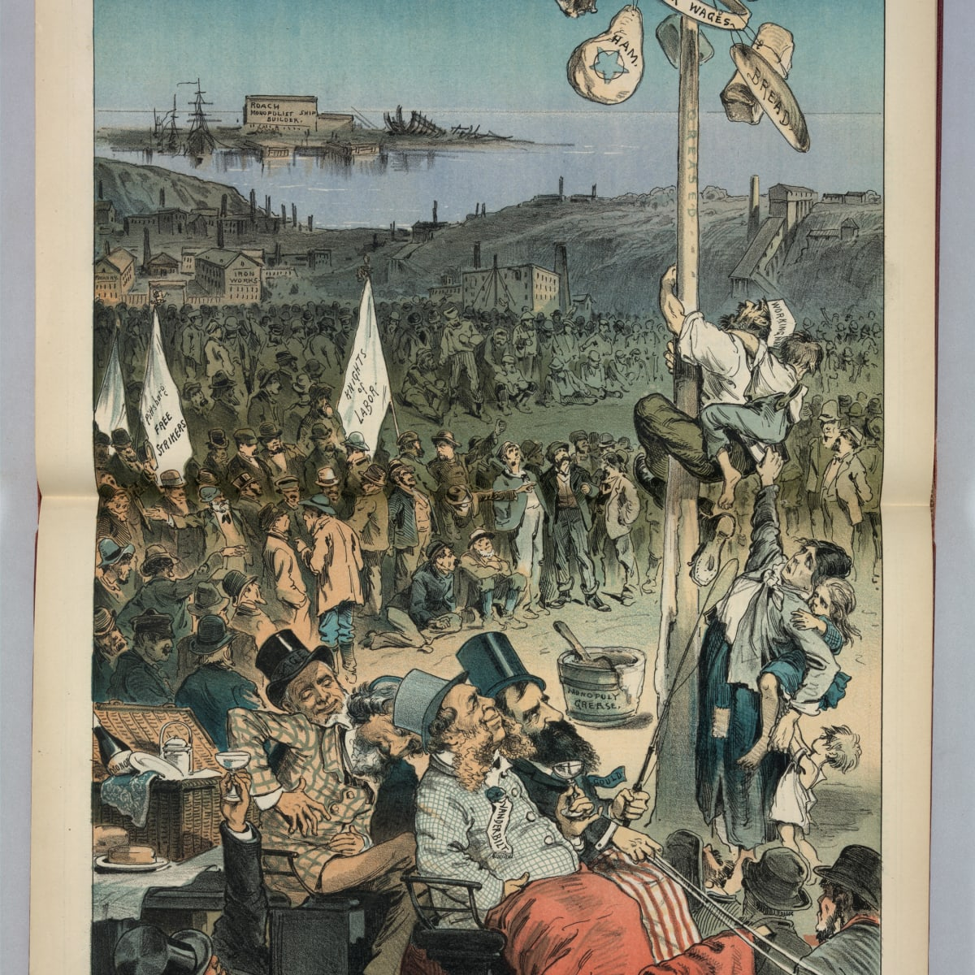
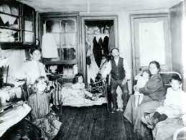
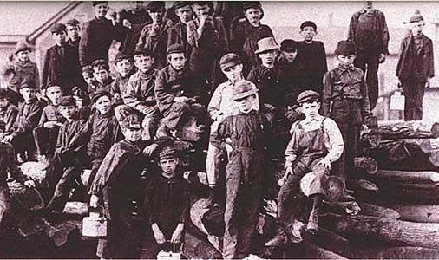
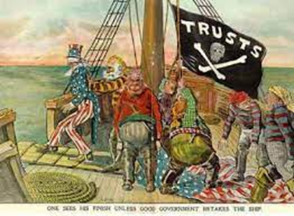

Slide 16
Rise of American Labour Unions
Originally craft –oriented labour unions existed -excluded women, blacks and Chinese though welcomed most European immigrants.
Railroads developed their own unions > the Great Railroad Strike of 1877 :
estimated 80,000 railroad workers and several hundred thousand other Americans (employed and unemployed)
”the largest strike anywhere in the world in the 19th century” (Beatty)
President Hayes intervened with federal troops
In the mid-1880’s – the Knights of labor grew rapidly and out of control; at its peak claimed 700,000 members
Strikes became routine events by the 1880’s as gap between rich and poor widened:
37,000 between 1881 and 1905
Most in bulidng trades and then coal miners
Main goal > improvement of working condition and settling which rival union was in control.

Slide 18
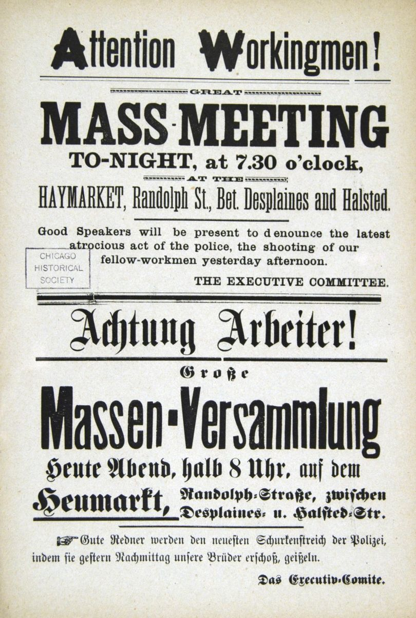
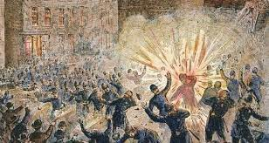
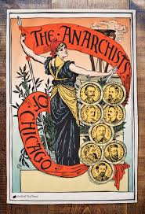
Chicago May 4th 1886
The Haymarket Riot started with a single stick of dynamite — and culminated in a wave of paranoia, police injustice, and activism that changed labor laws around the world.
And that one explosion set off a chain of events that turned six anarchists into martyrs, brought on America’s first “Red Scare,” turned May Day into an international holiday, and gave the United States an eight-hour workday.

Slide 19
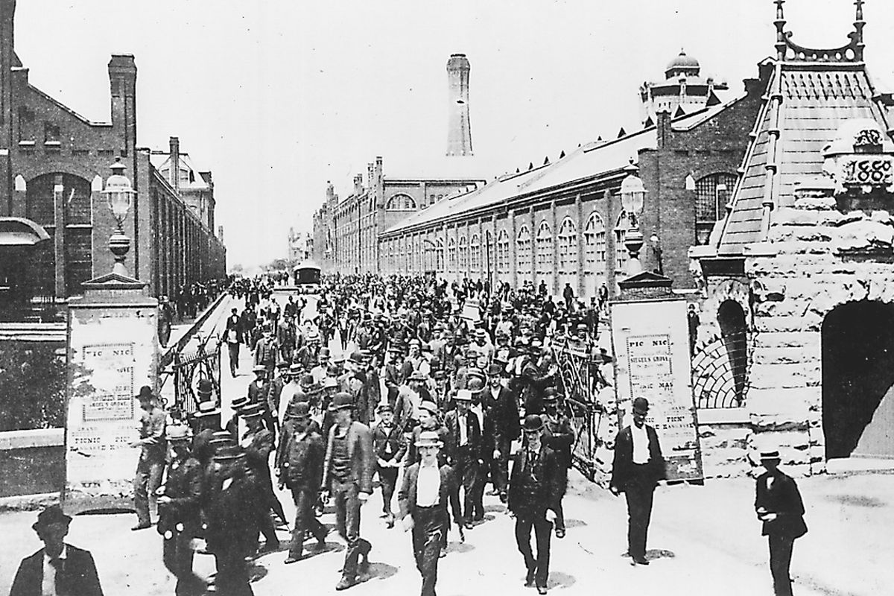
4,000 workers at the Pullman Company went on wildcat strike.
In the weeks that followed, more than 150,000 railroad workers across the country joined. The historic Pullman Strike of 1894 produced Labor Day and set Eugene V. Debs on a course of socialism
Debs was one of the founding members of the Industrial Workers of the World and five times the candidate of the Socialist Party of America for President of the United States
While there is a lower class, I am in it, while there is a criminal element, I am of it, and while there is a soul in prison, I am not free.
The 1894 Pullman Strike (May 11 –July 20)

Slide 20
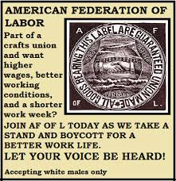
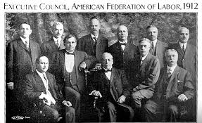
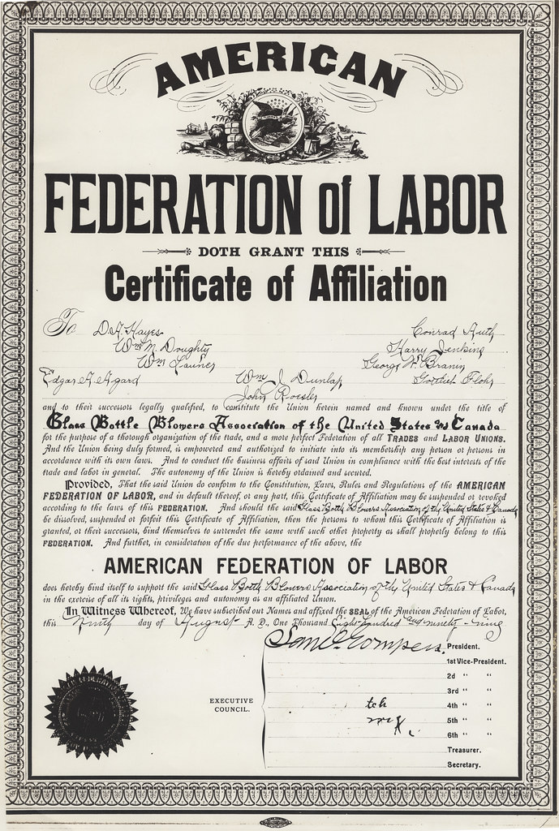
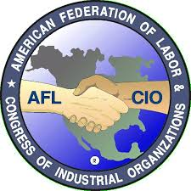
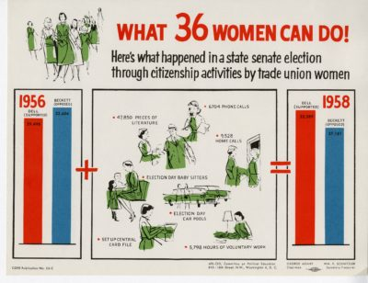
Samuel Gompers
Merger 1955

Slide 21
Populism Emerges…
Subsistence family farming with no government interference was far less common than a federally subsidized, capitalist model of farming and cattle raising for a national and even international markets.
Arid West areas were an environment impossibility
Homestead Act (Great Basin)offered semi-arid properties –productivity limited with less than 160 acres
Typically Congress granted the best land to railroads and allowed bigger interests to buy up large areas for agricultural businesses or stock raising and fencing it in.
Federal government resettled native Americans and opens land by suppressing indian insurrections
The populist revolt began as farmers banded together and called for cooperative farming, regulation of banks and railroads and an end to corporate monopolies
By mid 1870’s, A million small farmers joined the Grange movement of the 19th Century - an agricultural brotherhood that sought to foster mutual self-reliance and free themselves From middlemen and monopolies.

Slide 22
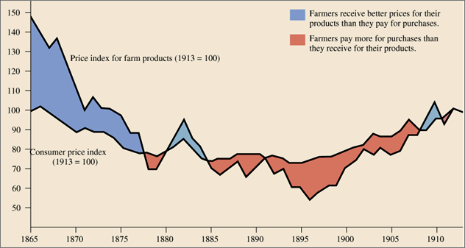

Slide 23
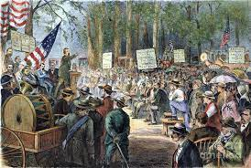
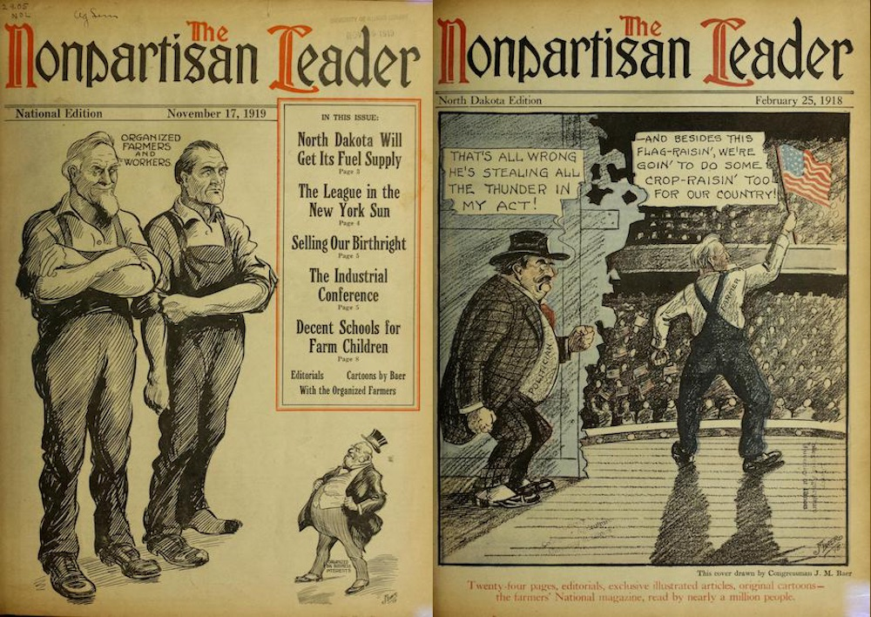
On July 4th, 1873 ,the Grange farmers issued a
Farmers’ Declaration of Independence
One of the largest American grassroots movements in the 19th century – And included women! Started by Oliver Kelly in Minnesota 1867
Nearly every state had a branch and by 1877, 20,000 granges existed –mainly in the Midwest

Slide 24
The Next Stage - The National Farmers Alliance (NFA)
Out of the Granger movement, the first Farmers Alliance is formed in Texas in 1877 and eventually becomes the National Farmers Alliance and Industrial Union – spread mainly in the South and Midwest later further West.
Sought to improve economic conditions for farmers through cooperatives and political advocacy
Banned African Americans who then established the Coloured Farmers National Alliance with similar goals
Between 1889 -1893, 90% of farmland fell into the hands of Banks through foreclosures
To effect change on a national level, the NFA founded a political party, The People’s or Populist Party and nominated James A Weaver as their candidate in the 1892 Presidential Election

Slide 25
Presidential Election of 1892

Slide 26
Populist Grievances
Federal Government supported the interest of businesses over those of labour, especially railroads, e.g. corporations not taxed
State Legislatures tried to tax railroad companies (e.g.California),
However, federal judges accepted arguments that such taxes were unconstitutional and accepted that such laws violated the rights of corporations as “persons”
1886 The Supreme Court Decision in Santa Clara County v. Southern Pacific R. Co., (1886) accepted the doctrine that corporations are persons within the meaning of the 14th Amendment (and all judges agreed)
In 1937, Supreme Court Justice, Hugo Black stated: “over the course of 50 years, only ½ of 1% of the 14th Amendment cases that came before the court had anything to so with African Americans or former slaves – half the cases were about protecting the rights of corporations.”

Slide 27
Women Enter Politics…
Lease helped found the Peoples Party through the NFA and said at the Kansas convention of1890 “ Let our motto be more money and less misery”

Slide 28
The Prohibition Party (1869) was the first party to support women’s right to vote 1872.
Frances Willard participates in the founding of the Women’s Christian Temperance Union 1874 and become its president in 1879 until her death in 1898. Declared support for women’s right to vote.
“ A Plea for the Temperance Ballot for Women”
(short hand for husbands who beat their wives and children and spent wages on drinking leaving families to starve)
This argument reshaped the nation’s political parties (Lepore)
Mottos: Home Protection and Do Everything
GOP (Republicans) failed to support either prohibition or suffrage > Willard founded The Home Protection Party which merged with the Prohibition Party 1882
American women entered politics “and when they came they came to stay.”

Slide 29
To advance their causes, both populists and suffragists, rejected by the major parties, turned to third party politics
At the 1880 Democratic National Convention, Susan B. Anthony hoped to deliver a speech calling on the party “to secure to twenty millions of women the rights of citizenship.”
Her statement in read by a male clerk instead and as the New York Times reported “No action whatever was taken with regard to it, and Miss Anthony vexed the convention no more”
On Centennial of 19th Amendment, Trump Pardons Susan B. Anthony and Targets 2020 Election

Slide 30
The museum dedicated to Susan B. Anthony objected to President Donald Trump’s pardon of the suffragette leader, saying the pardon “validated the proceedings” that led to her conviction.
Anthony, one of the leading figures in the movement to secure voting rights for women, was arrested for voting as a woman in Rochester, New York, in 1872, violating the laws that said only men could vote. She was convicted the following year by an all-male jury.
Men voted …Women marched into the Future

Slide 31
ATTACHMENTS
https://www.whitehouse.gov/about-the-white-house/presidents/
For information on Presidents of this period: Grant, Hayes, Garfield, Arthur, Cleveland, Harrison, Cleveland, McKinley…Roosevelt 1901

Slide 32
Attachment A The 14th Amendment - Ratified by Congress 9 July 1868
Section 1. “All persons born or naturalized in the United States, and subject to the jurisdiction thereof, are citizens of the United States and of the State wherein they reside. No State shall make or enforce any law which shall abridge the privileges or immunities of citizens of the United States; nor shall any State deprive any person of life, liberty, or property, without due process of law; nor deny to any person within its jurisdiction the equal protection of the laws.”
Section 2. Repeals the 3/5th clause –clarified that all residents, regardless of race, should be counted as one whole person and guaranteed that all citizens over age 21 had the right to vote.
Section 3. Congress has authority to bar public officials , who took an oath of allegiance to the US Constitution, from holding office if they “engaged in insurrection or rebellion” against the Constitution
Section 4. Prohibits payment of any debt owed to the defunct Confederate States of America and any payments to former enslavers as compensation for loss of human “property”.
Section 5. Congress shall have the power to enforce, by appropriate legislation, “the provisions of this article”.

Slide 33
Attachment B
Details of the Pullman Strike 1894 – A coordinated effort to shut down the national railroad system
After financial reversals caused the Pullman Palace Car Co. to cut wages by 25%, local union members called a strike.
The company’s president, George Pullman, refused arbitration, and union president Eugene V. Debs called for a nationwide boycott of Pullman cars. Sympathy strikes followed in 27 states.
Violence broke out in Chicago, Ill., but Gov. John Peter Altgeld refused to intervene. The U.S. attorney general, Richard Olney, obtained an injunction against the strikers for impeding the mail service, and federal troops were called in.
Debs’s conviction for conspiring against interstate commerce established that the Sherman Antitrust Act could be enforced against labour-unions.
The American Railroad Union eventually vanished and traditional railroad brotherhoods survived and avoided strikes.

