Slide 1
The Run Up to The American Revolution Causes & Consequences Discussion Guide
U3A in Kennet – American History Group
18th February 2020

Slide 2
Today’s Topics
The conflicts that preceded the war – huge repercussions
Relationship between the Colonies & England – taxes
The rabble (or statesmen) and the press, plus the people
Three specific events
The Boston Massacre (March 1770)
The Boston Tea Party (December 1773)
Lexington and Concord (April 1775)

Slide 3
The Seven Years War > The French and Indian War
Seven Years War (1756–63)
A global war that involved all five European great powers of the day, plus many of the middle powers – spanning five continents.
War basically about world trade, empire, imperialism & world domination.
Three earlier phases of this extended contest for overseas mastery included King William’s War (1689–97), Queen Anne’s War (1702–13), and King George’s War (1744–48).
Primarily fought in Europe with two broad coalitions: one was led by the Kingdom of Great Britain, the other led by the Kingdom of France.
Fallout from this war changed the ultimate control of the vast colonial territory of North America.
Notes:
The English side included the Kingdom of Prussia, the Kingdom of Portugal, the Electorate of Brunswick-Lüneburg (also named Hanover), and a few other small German states.
The French side included the Austrian-led Holy Roman Empire, including the Electorate of Saxony and most of the smaller German states, the Russian Empire (until 1762), the Kingdom of Spain, and Sweden.

Slide 4
The Seven Years War > The French and Indian War
The French and Indian War (1756 and 1763)
Fought between France and Great Britain – it was the American (colonial) phase of the Seven Years’ War.
Struggle between the French and English over colonial territory and wealth.
The biggest issue was whether the upper Ohio River valley was a part of the British Empire, and therefore open for trade and settlement by Virginians and Pennsylvanians, or part of the French Empire.
Behind this issue loomed an infinitely larger one: Which national culture was to dominate the heart of North America. English settlers were the majority in the coveted area, but French exploration, trade, and alliances with Native Americans predominated.
The French and Indian War was the American theatre of the worldwide Seven Years' War; however, in the colonies, the French and Indian War is viewed as a singular conflict which was not associated with any European war.
French Canadians call it Guerre de la Conquête ("War of the Conquest").

Slide 5
Anglo-French Wars
High Middle Age
Anglo-French War (1109–1113) – First conflict between the Capetian Dynasty and the House of Normandy
Anglo-French War (1116–1119) – Conflict over English possession of Normandy
Anglo-French War (1123–1135) – Revolt in northern France that amalgamated into The Anarchy
Anglo-French War (1158-1189) – First conflict between the Capetian Dynasty and the House of Plantagenet
Anglo-French War (1193–1199) – Conflict between King Richard the Lionheart and King Philip Augustus
Anglo-French War (1202–1204) – French invasion of Normandy
Anglo-French War (1213–14) – Conflict between King Philip Augustus and King John of England
French intervention in England (1215–1217) – part of the First Barons War
Anglo-French War (1224) – known as the Poitou War
Anglo-French War (1242–43) – known as the Saintonge War
Late Middle Ages
Anglo-French War (1294-1303) – known as the Guyenne War
Anglo-French War (1324) – War of Saint-Sardos
Hundred Years' War (1337–1453) – Series of conflicts which lasted 116 years
Anglo-French War (1496–1498) – part of the Italian War of 1494–1498
Modern period
Early modern period
1500’s and 1600’s
Anglo-French War (1512–1514) – part of the War of the League of Cambrai
Anglo-French War (1522–1526) – part of the Italian War of 1521–1526
Anglo-French War (1542–1546) – part of the Italian War of 1542–1546
Anglo-French War (1557–1559) – part of the Italian War of 1551–1559
Anglo-French War (1627–1629) – English intervention during the Huguenot rebellions
Anglo-French War (1666–67) – minor corollary of the Second Anglo-Dutch War
Nine Years' War (1689–1697) – includes King William's War and Williamite War
1700’s
War of the Spanish Succession (1702–1713) – includes Queen Anne's War
War of the Austrian Succession (1744–1748) – includes King George's War
Carnatic Wars (1746–1763) – Colonial conflicts in India
Anglo-French War (1756–1763) – Part of the Seven Years' War; includes the French and Indian War
Anglo-French War (1778–1783) – part of the American Revolutionary War; includes the Fourth Anglo-Dutch War
Anglo-French War (1793–1802) – part of the French Revolutionary Wars
Late modern period
Anglo-French War (1803–1815) – part of the Napoleonic Wars

Slide 6
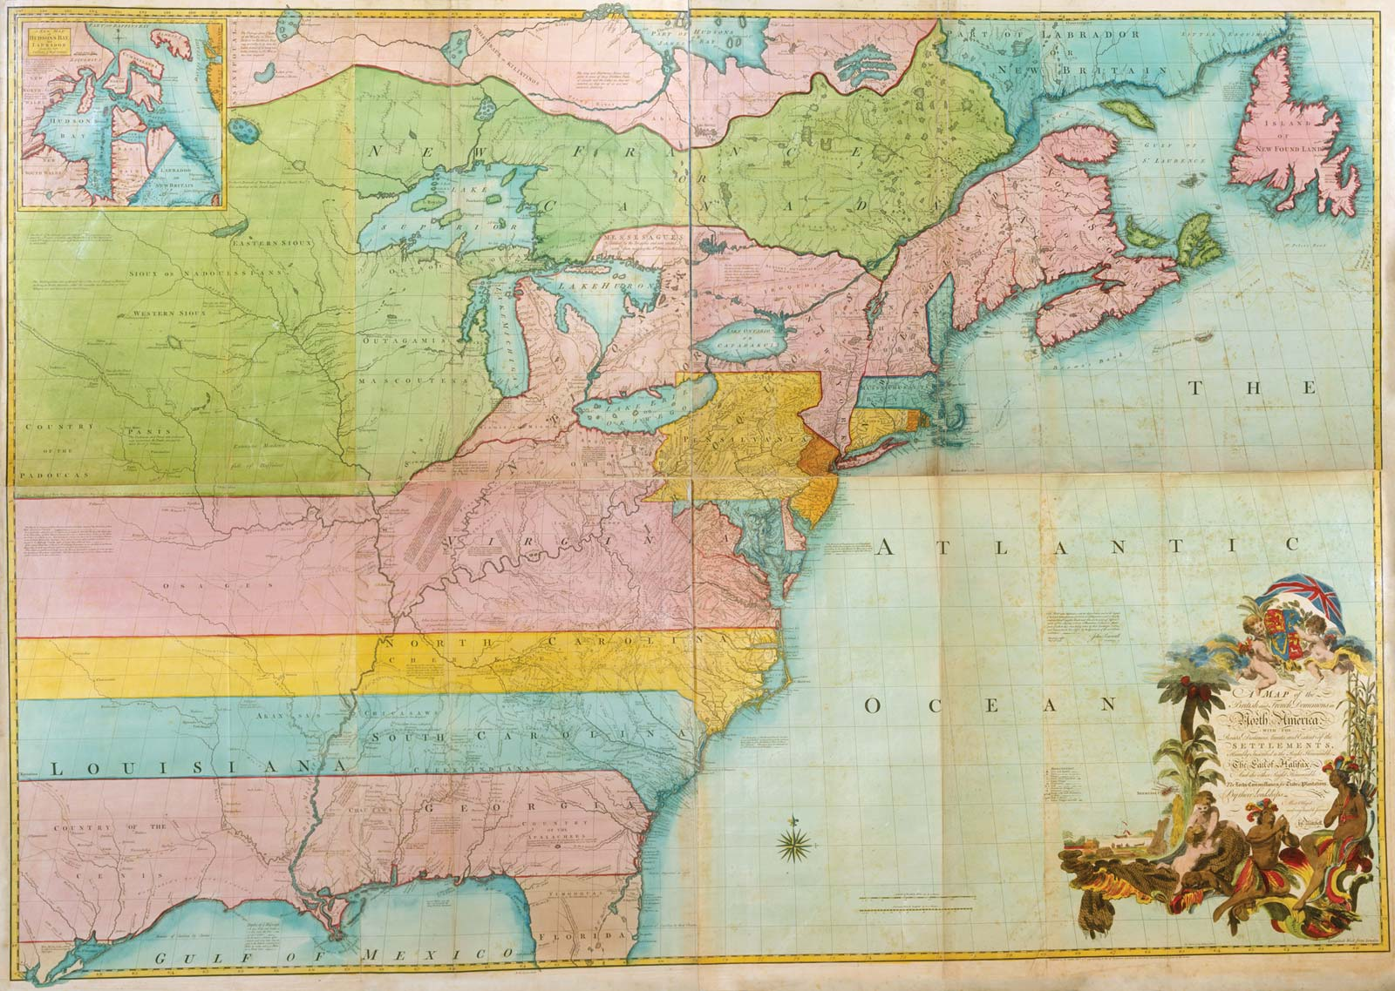
1755 – The way colonies viewed the ‘west’

Slide 7
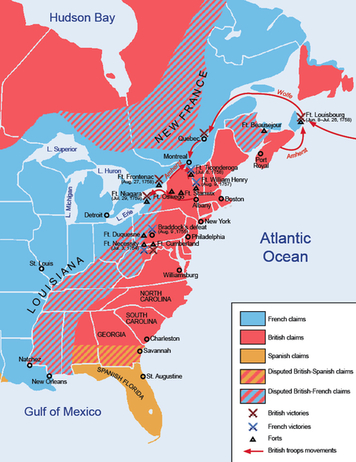
Conflict between the two colonial powers was undoubtedly inevitable
But because their areas of trade exploitation were widely separated, that conflict might have been delayed for many years.
However, the French forced the issue.
They compelled the trading houses in that region to lower the British flags that flew above them.
The traders, regarded as trespassers on French lands, were ordered to retreat to the eastern slopes of the Appalachians.

Slide 8
In November 1753, the governor or Virginia sent Major George Washington (age 22) with a small expedition to order the removal of the French forts.
The commander of the fort politely received Washington and his men, but denied the validity of English claims to the region.
Washington returned to Virginia and soon thereafter, the legislature determined that French rejection of British demands constituted a hostile act, and that the French must be driven from the British-claimed land.
Washington received permission to build a fort near the present site of Pittsburgh.
In May, after Washington's troops clashed with local French forces the colonists surrendered the meagre fort they had built.
The incident set off a string of additional small battles, but it was not until May 1756 that the French and the English formally declared war.

Slide 9
By September 1760, the British controlled all of the North American frontier; the war between the two countries was effectively over.
The 1763 Treaty of Paris, which also ended the European Seven Years War, forced the French to surrender all of her American possessions to the British and the Spanish.
The results of the war effectively ended French political and cultural influence in North America.
England gained massive amounts of land and vastly strengthened its hold on the continent.

Slide 10
Consequences
French forced to surrender all American possessions to the British and Spanish governments (see map next page)
The war also affected the Indians / Native Americans
Before the war, the English & French had significantly different relationships with the Indians
After the war, the relationship between the English & Indians deteriorated even more (it wasn’t great to begin with)
It also left England with a great deal of debt
With this enormous debt, Parliament took steps to ease the debt burden and also gain greater control of the colonies

Slide 11
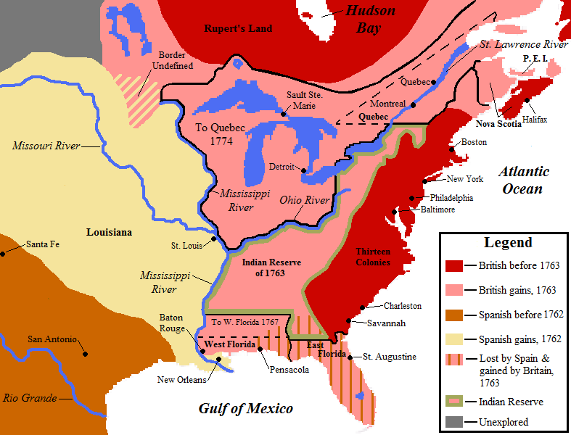
Post 1763

Slide 12
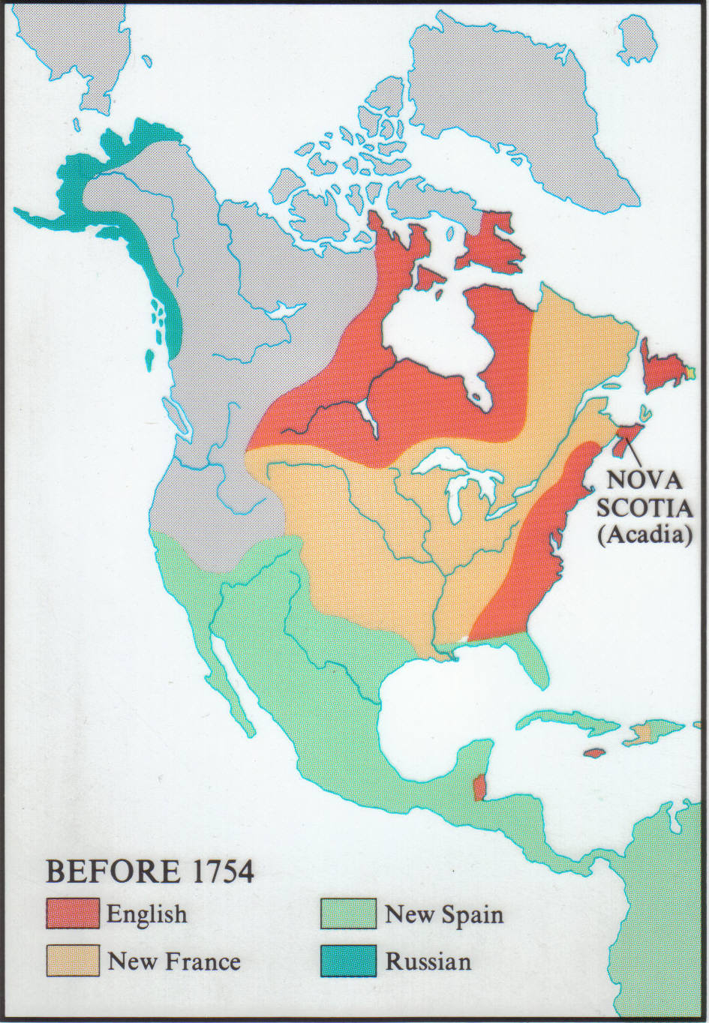
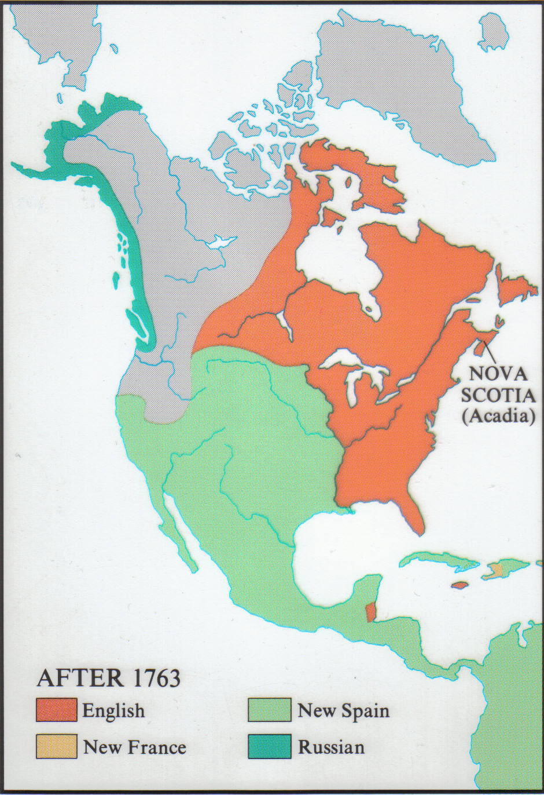

Slide 13
England’s Perspective
This huge debt had to be re-paid
Parliament said it had fought the long and costly war to protect its American subjects from the powerful French in Canada
Parliament said it was right to tax the colonists to help pay the bills for the war
Furthermore
Colonies were forbidden to trade with the enemy – or they had to pay heavy import taxes if they did
Colonies were forbidden to ship goods or produce in enemy ships
Colonies were forbidden to engage in manufacturing activities that competed with English citizens
Colonies were forbidden to create laws or institutions that ran counter to those of England

Slide 14
The Colonies Perspective
England’s war served England’s goals, mostly to strengthen its empire and increase its wealth, not to benefit its colonies
Parliament was elected by people living in England (the colonists could not vote) and felt they were not adequately represented
Parliament did not have the right to take their money by imposing taxes – "No taxation without representation" became the American rallying cry
The crest of Appalachians designated as Indian Country incensed the Colonists
Further, they resented not only having to buy goods exclusively from the British but having to pay tax on them as well
A lot of the tax was never collected because there were riots all over the place
Ultimately, Benjamin Franklin convinced the British to rescind it
But that only made things worse and it convinced the colonies that they could push back against England

Slide 15
So….
Proclamation of 1763 Indian lands – not colonies
Sugar Act of 1764
Quartering Act of 1764 quartering of 10,000 English troops
Stamp Act of 1765 transactions
Townshend Acts of 1767 imports
Suspension of Trial by Jury in 1768
Tea Act of 1773
The Coercive/Intolerable Acts of 1774 restitution and punishments
Boston Port Act
Massachusetts Government Act
Administration of Justice Act
Quartering Act

Slide 16
Three Major Events
The Boston Massacre (March 1770)
The Boston Tea Party (December 1773)
Lexington and Concord (April 1775)

Slide 17
The Boston Massacre (March 1770)
Simmering tensions between the British occupiers and Boston residents boiled over one late afternoon, when a disagreement between an apprentice wigmaker and a British soldier led to a crowd of 200 colonists surrounding seven British troops. When the colonists began taunting the British and throwing things at them, the soldiers apparently lost their cool and began firing into the crowd.
As the smoke cleared, three men were dead, and two others were mortally wounded. The massacre became a useful propaganda tool for the colonists, especially after Paul Revere distributed an engraving that misleadingly depicted the British as the aggressors.

Slide 18
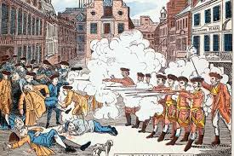

Slide 19
The Boston Tea Party (December 1773)
The British eventually withdrew their forces from Boston and repealed much of the onerous Townshend legislation. But they left in place the tax on tea, and in 1773 enacted a new law, the Tea Act, to prop up the financially struggling British East India Company. The act gave the company extended favourable treatment under tax regulations so that it could sell tea at a price that undercut the Colonial merchants who were importing from Dutch traders.
This didn’t sit well with the Colonialists. They didn’t want the British telling them that they had to buy their tea, not only that, they wanted to be able to trade with any country – not just England.
The ‘Sons of Liberty’, a radical group, decided to confront the British head-on. Thinly disguised as Mohicans, they boarded three ships in Boston harbour and destroyed more than 92,000 pounds of British tea by dumping it into the harbour. To make the point that they were rebels rather than vandals, they avoided harming any of the crew or damaging the ships themselves, and the next day even replaced a padlock that had been broken.
Nevertheless, the act of defiance really ticked off the British government. Many of the East India Company’s shareholders were members of Parliament. They each had paid £1,000 (about $1 million in todays’ money) for a share of the company. These bottom-of-the-rung people in Boston destroying their tea did not sit well.

Slide 20
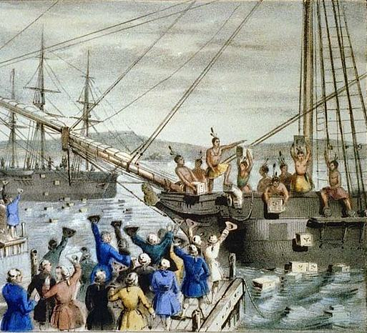

Slide 21
Lexington and Concord (April 1775)
British General Thomas Gage led a force of British soldiers from Boston to Lexington, where he planned to capture colonial radical leaders Sam Adams and John Hancock, and then head to Concord and seize their gunpowder. But colonial spies got wind of the plan, and with the help of riders such as Paul Revere, word spread to be ready for the British.
On the Lexington Common, the British force was confronted by 77 colonial militiamen, and they began shooting at each other. Seven colonists died, but other militiamen managed to stop the British at Concord, and continued to harass them on their retreat back to Boston.
The British had 73 dead, with another 174 wounded and 26 missing in action. The bloody encounter proved to the British that the colonists were fearsome foes who had to be taken seriously. It was the start of America’s war of independence.

Slide 22
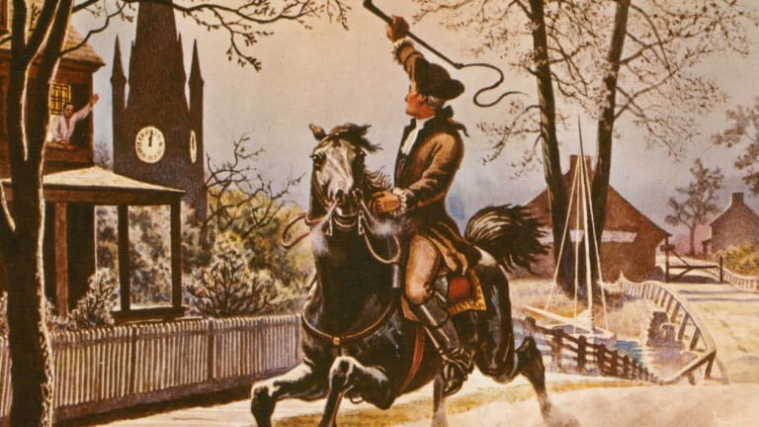
"Paul Revere's Ride" (1860) is a poem by American poet Henry Wadsworth Longfellow that commemorates the actions of American patriot Paul Revere on April 18, 1775, although with significant inaccuracies. It was first published in the January 1861 issue of The Atlantic Monthly.

Slide 23
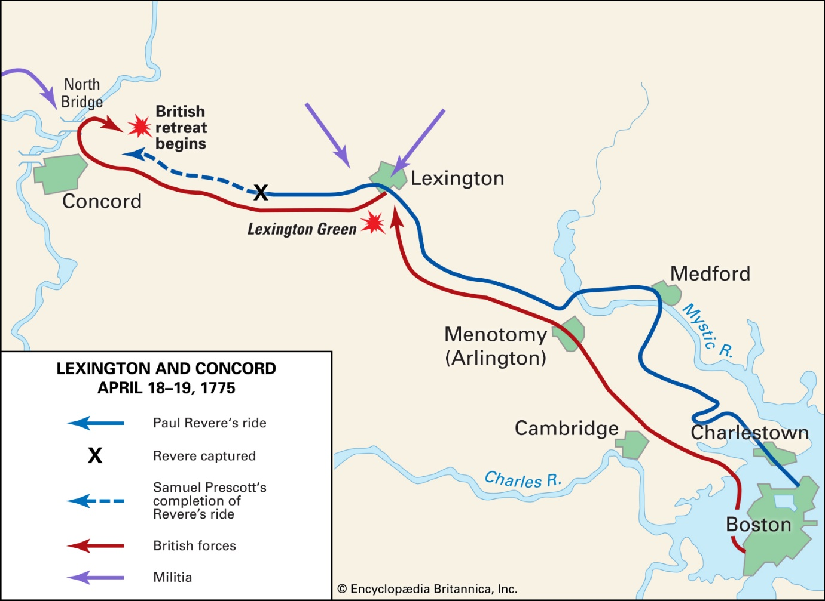

Slide 24
WAR!!!!
By mid-July 1775 things continued to escalate – the war had started
The war was:
A war of independence from colonial domination
A civil war between the various forces within American society
And, part of a world war fought both in North America and on the European continent
Regardless, the Revolutionary War placed Americans on an evolutionary road to creating a more democratic nation – which took another 14 years to establish with significant growing pains continuing long after that.

Slide 25
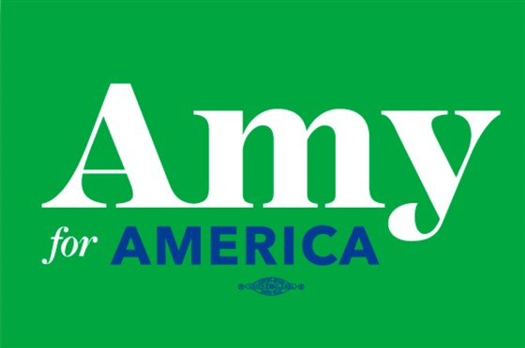
Next Time - Biographies
George Washington
Thomas Jefferson
Benjamin Franklin
James Madison
Samuel Adams
John Adams
Alexander Hamilton
Patrick Henry
Nathan Hale
Thomas Paine

