Slide 1
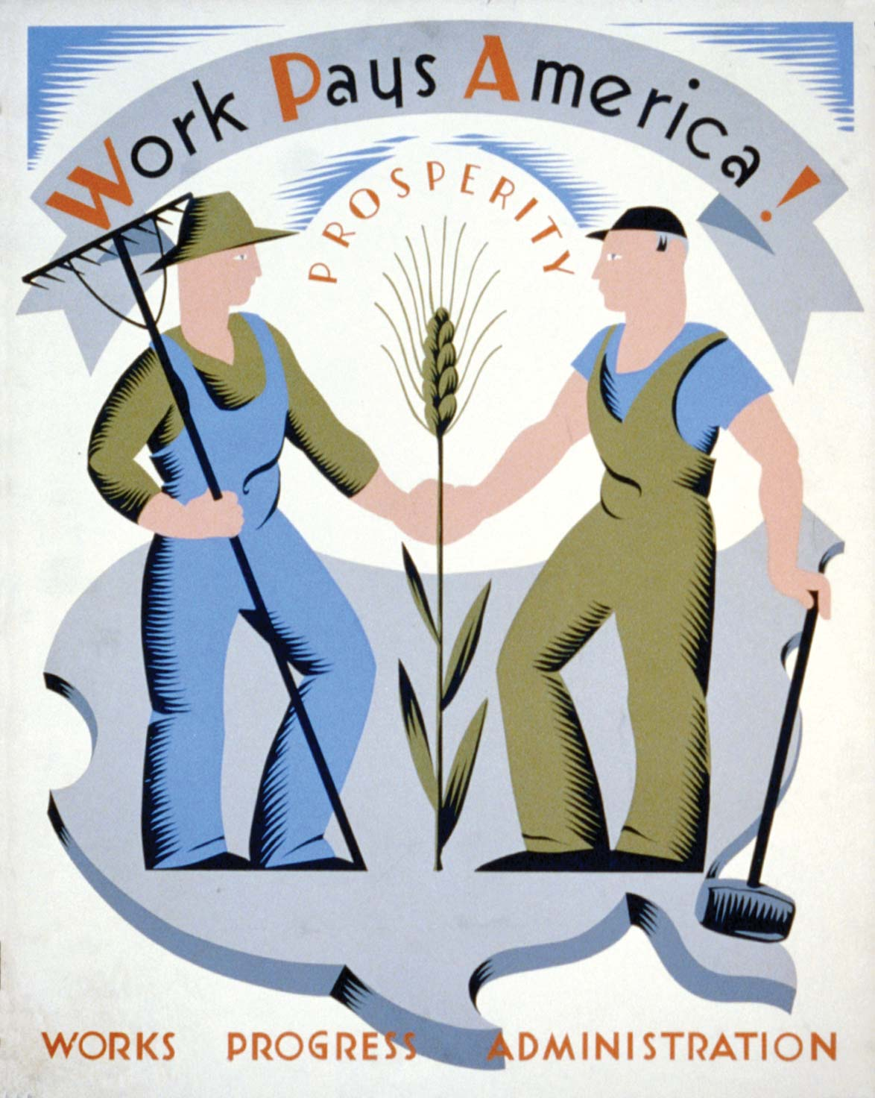
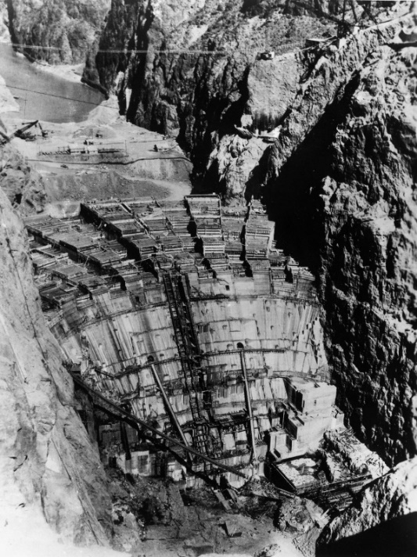
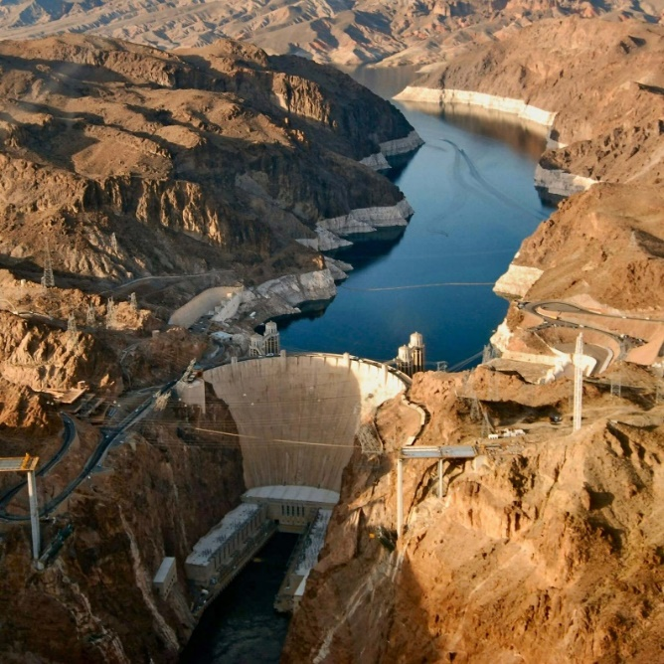
The Infrastructure Projects of Roosevelt’s New Deal
The Hoover Dam, Nevada

Slide 2
Background history
The 1930’s were an historic low in the USA. When FD Roosevelt was inaugurated on March 4, 1933, the U.S. was at the peak of the worst depression in it’s history.
A quarter of the workforce was unemployed. Farmers were in deep trouble as prices had fallen by 60%. Industrial production had fallen by more than half since 1929. Two million people were homeless. By the evening of March 4, 32 of the 48 states – as well as the District of Columbia – had closed their banks.
Former President Hoover had argued that patience & self reliance were all that was needed to see the country through this depression. He “suggested” that local government undertook projects but it is telling that the shanty towns that grew up as people lost farms, homes and livelihoods were nicknamed “Hoovervilles”
FDR was elected in 1932 having pledged to use the power of the Federal Govt to make lives better. Over the next 9 years his New Deal created a new, and continuing, role for Government involvement in the lives of Americans.
FDR’s first 100 days saw 15 major laws passed “waging a war against the emergency”. This did much to restore confidence. One of the biggest infrastructure projects was created in these days by the Tennessee Valley Authority Act.

Slide 3
FDR Inauguration speech﻿
“I pledge you, I pledge myself, to a new deal for the American people,” he told the roaring crowd in Chicago Stadium, straw hats waving. “Let us all here assembled constitute ourselves prophets of a new order of competence and of courage. This is more than a political campaign; it is a call to arms. Give me your help, not to win votes alone, but to win in this crusade to restore America to its own people.”
Republicans often said, as they’d said about William Jennings Bryan, that while listening to Roosevelt, they found themselves agreeing with him, even when they didn’t. “All that man has to do is speak on the radio, and the sound of his voice, his sincerity, and the manner of his delivery, just melts me,” one said.
The New Deal “is as old as Christian ethics, for basically its ethics are the same,” Roosevelt liked to say. “It recognizes that man is indeed his brother’s keeper, insists that the laborer is worthy of his hire, demands that justice shall rule the mighty as well as the weak.”

Slide 4
On May 6 1935 FDR established the Works Progress Administration (latterly the Public Works Administration). This body encompassed many divisions working in all areas of the Economy.
The infrastructure projects were administered by the Division of Engineering and Construction with the Division of Professional and Service projects. This presentation focusses on the former but the scope of the latter was immense also:
Federal Project Number One. This had 5 different parts:
Federal Art Project
Federal Music Project
Federal Theatre Project
Federal Writers Project
Historical Records Survey
We should also recognise the other major changes in social support being enacted:
In 1935 the National Labor Relations Act guaranteed the right of workers to unionise and undertake collective bargaining. By 1937 some 8m workers were unionised.
Also in 1935 the Social Security Act introduced guaranteed pensions for some and care for dependent children and the disabled.
America was changing and changing fast.

Slide 5
We could spend many hours exploring the projects undertaken by the WPA but I’m focussing on just a few, chosen in terms of scale, impact or just surprising and interesting to me!
The choice I’ve made is :
Hoover Dam
Triborough Bridge
La Guardia Airport
Arroyo Seco Parkway
Camp David
Dealey Place Plaza
One of the best sites I found is The Living New Deal, this is a site dedicated to “uncovering the immense riches of New Deal public works. You can search by name, state, category and it is logs over 17,000 projects - truly amazing the “New Deal” works that are still in “use” today.
https://livingnewdeal.org/about/

Slide 6
HOOVER DAM
Probably the most famous of New Deal projects is the Hoover Dam. Although it was started in the 1920’s it was competed with an injection of funds from the PWA.
At the time of its construction, Hoover Dam was mankind’s most massive masonry structure since the Great Pyramids. In all, it took this―and more―to create Hoover Dam:
4.4 million cubic yards of concrete
88 million pounds of plate steel and outlet pipes
6.7 million pounds of pipe and fittings
45 million pounds of reinforced steel
The project also stands out for something on a much smaller scale. It’s believed to be the first sizable construction job on which wearing hard hats (or hard-boiled hats, as they were originally called) was mandatory for all.
By any measure, Hoover Dam is amazing. It looms 726 feet (221 meters) above Black Canyon on the Arizona-Nevada state line. It’s 660 feet (201 meters) wide at the base and 1,244 feet (379 meters) across at the top.
It weighs 6.6 million tons.
Behind the dam, Lake Mead is the country’s largest reservoir, capable of holding more than 9 trillion gallons (that’s 3.41 × 1,013 litres) of water from the Colorado River. Water from the lake drives turbines inside the dam that generate electricity for Arizona, Nevada, and Southern California.

Slide 7
The first difficult step of construction involved blasting the canyon walls to create four diversion tunnels for the water. Facing strict time deadlines, workers toiled in 140-degree temperature tunnels choked with carbon monoxide and dust, conditions that prompted a six-day strike in August 1931. When two of the tunnels were complete, the excavated rock was used to form a temporary coffer dam that successfully rechannelled the river’s path in November 1932.
The second step of involved the clearing of the walls that would contain the dam. Suspended from heights of up to 800 feet above the canyon floor, high scalers wielded 44-pound jackhammers and metal poles to knock loose material, a treacherous task that resulted in casualties from falling workers, equipment and rocks.
Meanwhile, the dried riverbed allowed for construction to begin on the powerplant, four intake towers and the dam itself. Cement was mixed onsite and hoisted across the canyon on one of five 20-ton cableways, a fresh bucket capable of reaching the crews below every 78 seconds. Offsetting the heat generated by cooling concrete, nearly 600 miles of pipe loops were embedded to circulate water through the poured blocks, with workers continually spraying the concrete to keep it moist.
As the dam rose from the canyon floor, the visual renderings of architect Gordon Kaufmann took form. Electing to emphasize the imposing mass of the structure, Kaufmann kept the smooth, curved face free of adornment. The powerplant was given a futuristic touch with horizontal aluminium fins for windows, while its interior was designed to pay homage to Native American cultures.

Slide 8
“The project is now substantially completed at an expenditure of nearly $140,000,000 toward which $38,000,000 was contributed by the P.W.A.”
(Short and Stanley-Brown 1939)
The impact of the Hoover Dam on this part of the USA was and still is immense.
Labourers descended on Las Vegas and set up camp in the surrounding desert. Those hired were oved to Boulder City – specifically built to house the workers. Today Boulder City has a population of about 15,000.
The Hoover Dam project fuelled the development of such major cities as Los Angeles, Las Vegas and Phoenix.
Capable of irrigating 2 million acres, its 17 turbines generate enough electricity to power 1.3 million homes.
The dam was designated a National Historic Landmark in 1985 and one of America’s Seven Modern Civil Engineering Wonders in 1994.
It receives some 7 million visitors annually, while Lake Mead, the USA’s largest reservoir, hosts another 10 million as a popular recreation area.

Slide 9
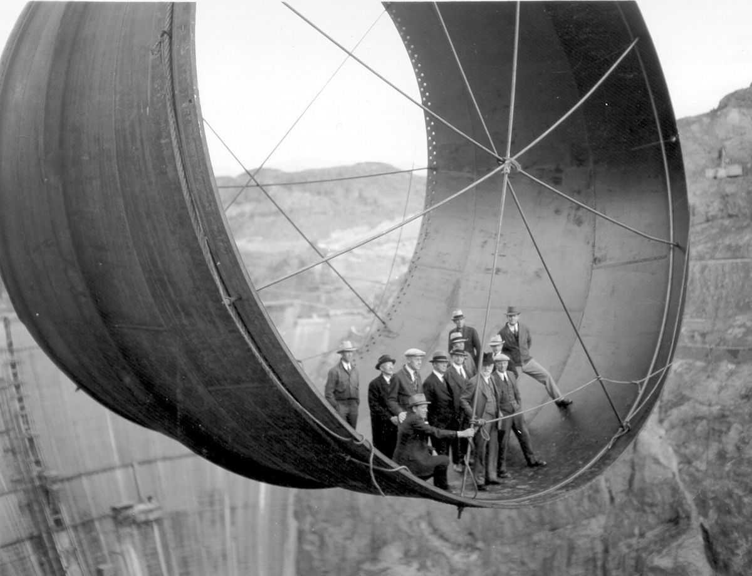
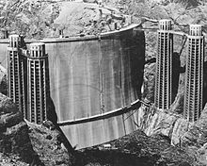
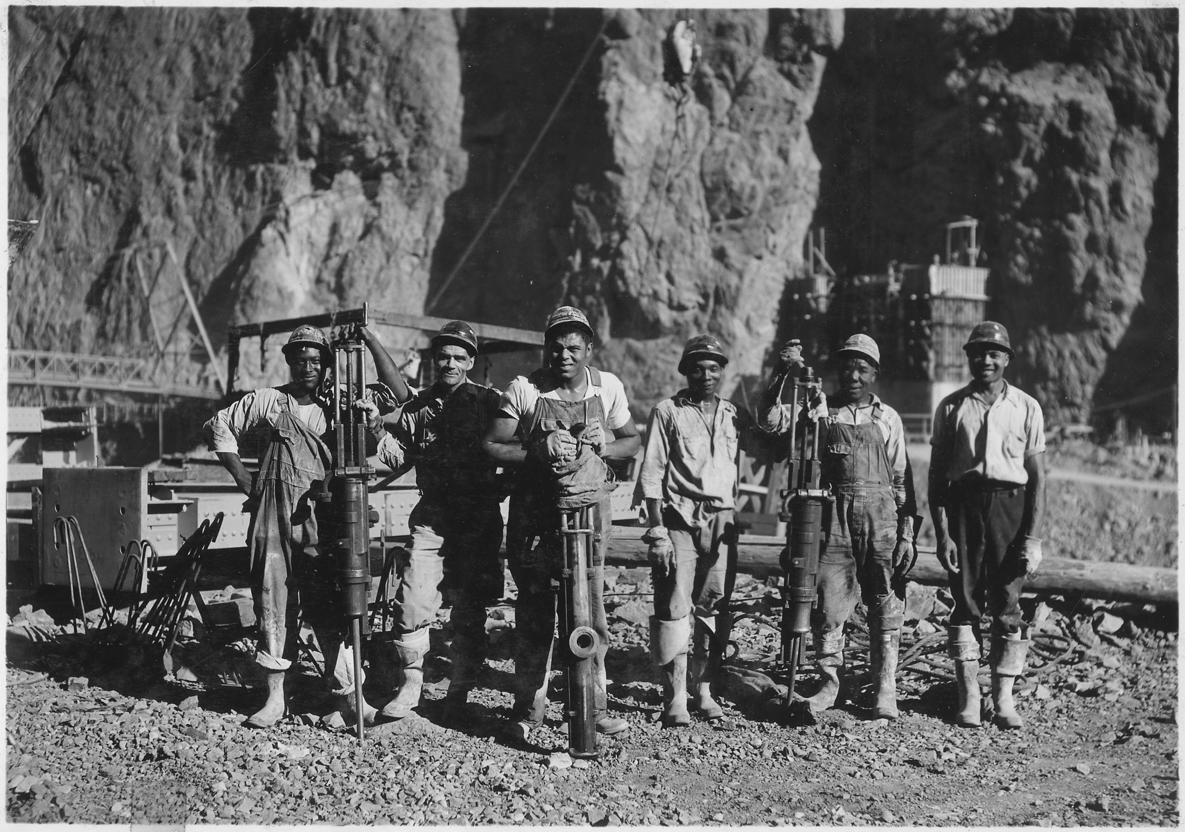
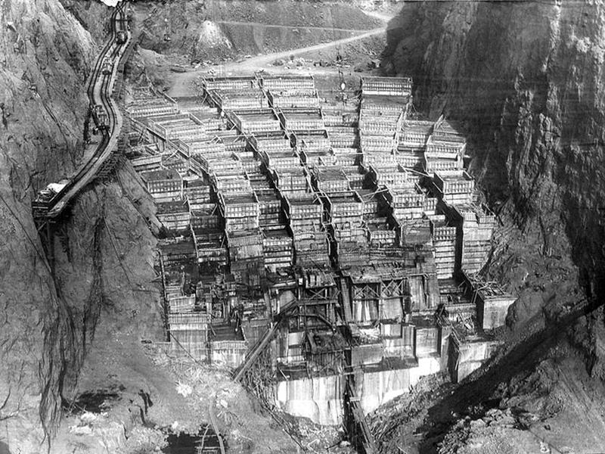
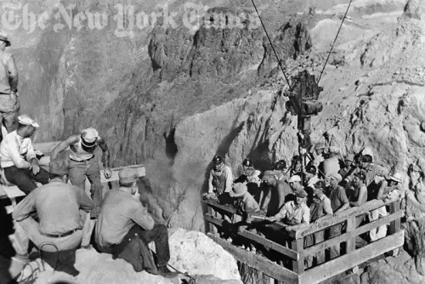
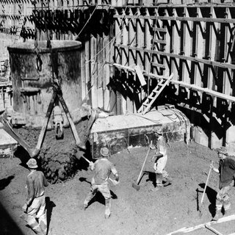
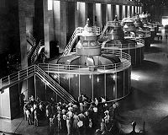
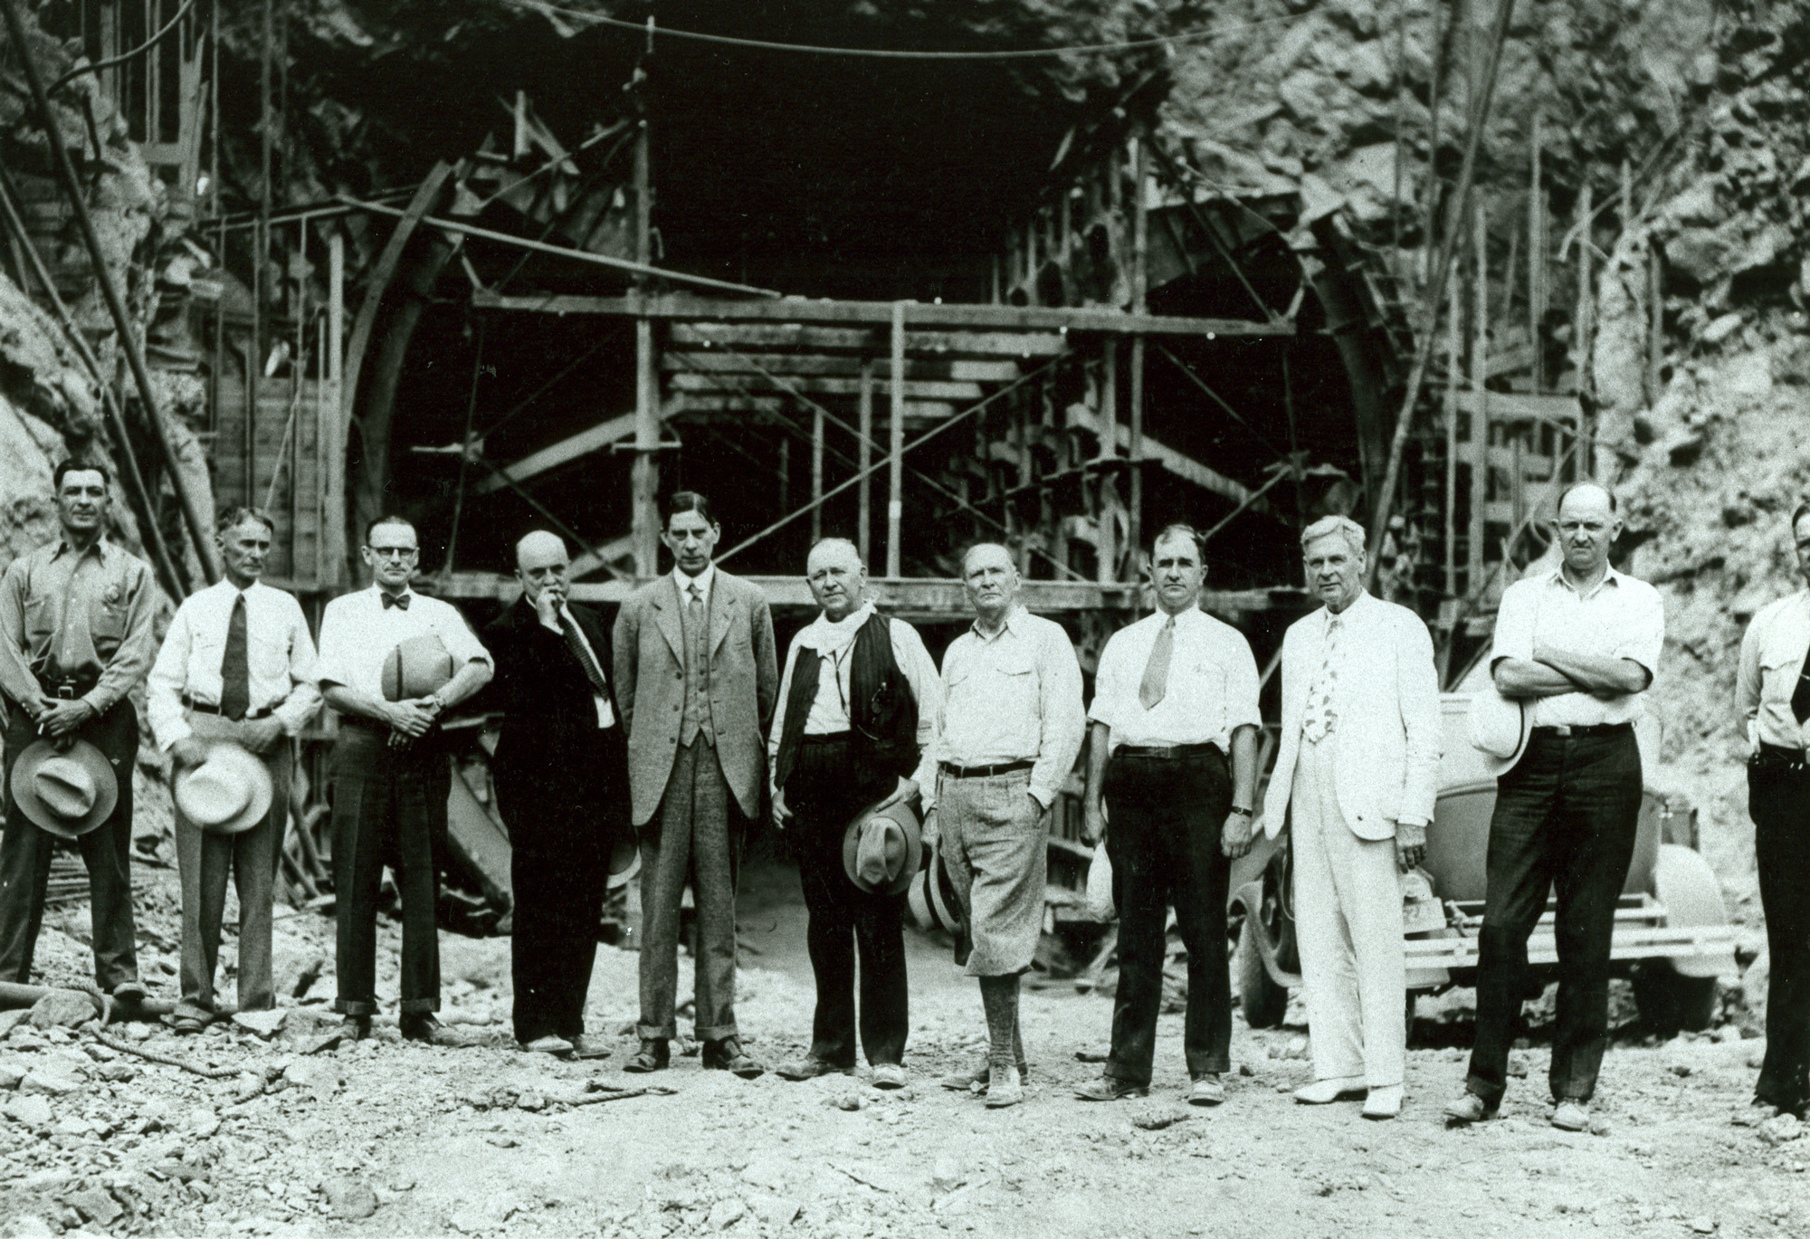
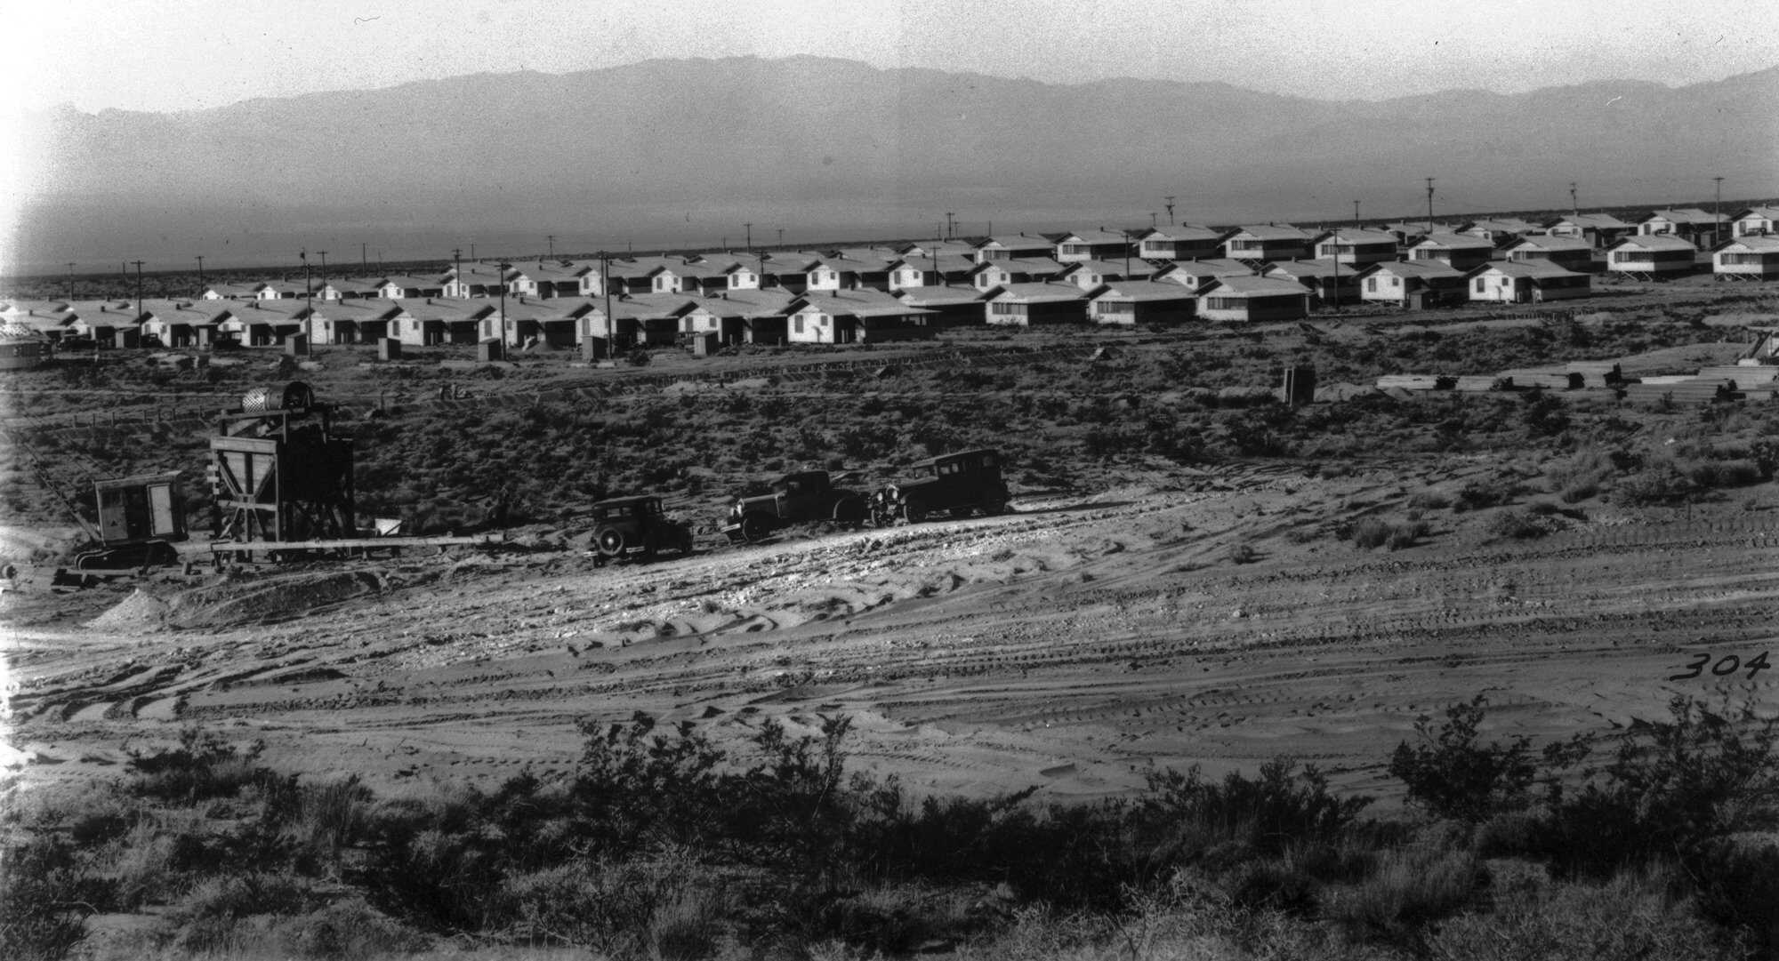

Slide 10
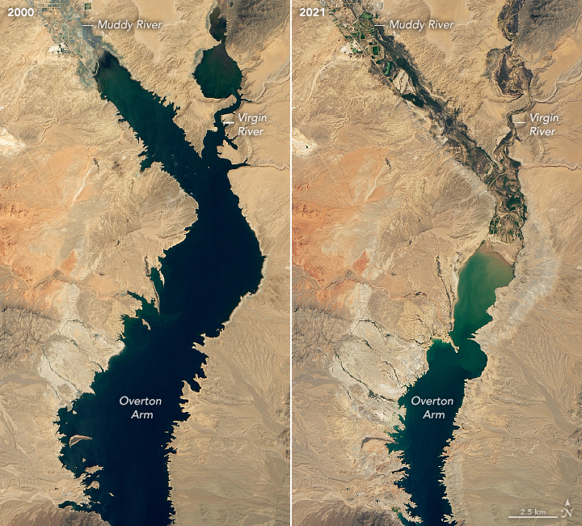
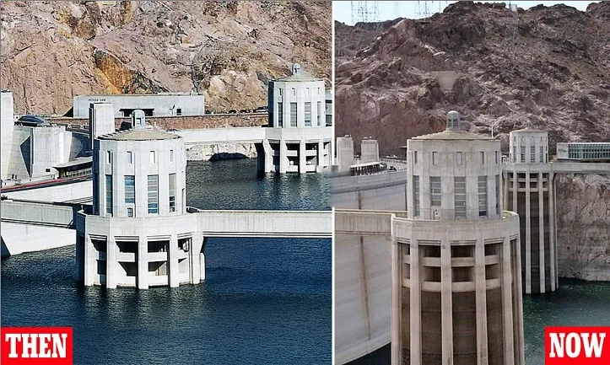
HOOVER DAM
This is a very good video of just 5 minutes:
https://youtu.be/Qjz-DvzkHMw
Modern day problems are the water shortage and drought conditions in the watershed of Lake Mead. These pictures show the dramatic changes being felt. As of June 2021 the lake held just 35% of it’s capacity.
It is projected that the resulting drop in downstream water delivery will seriously impact power production and irrigation capability.

Slide 11
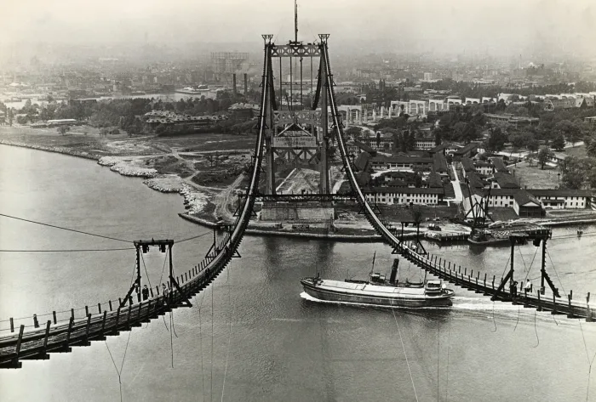
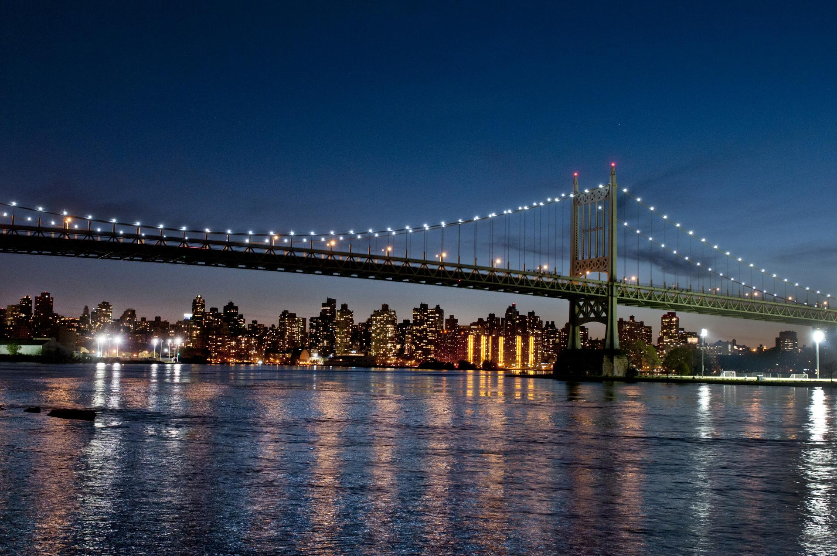
TRIBOROUGH BRIDGE
This bridge ( now the Robert F Kennedy Bridge) is actually three bridges, a viaduct, and 14 miles of approach roads and it connects Manhattan, Queens and the Bronx in New York.
The powerful New York City official Robert Moses led construction of the bridge, which opened in 1936.
At the dedication ceremony FDR placed the bridge within the larger context of New Deal projects, saying, “People require and people are demanding up-to-date government in place of antiquated government, just as they are requiring and demanding Triborough Bridges in the place of ancient ferries.”
The bridge “brought together” parts of the City in a way never before experienced.

Slide 12
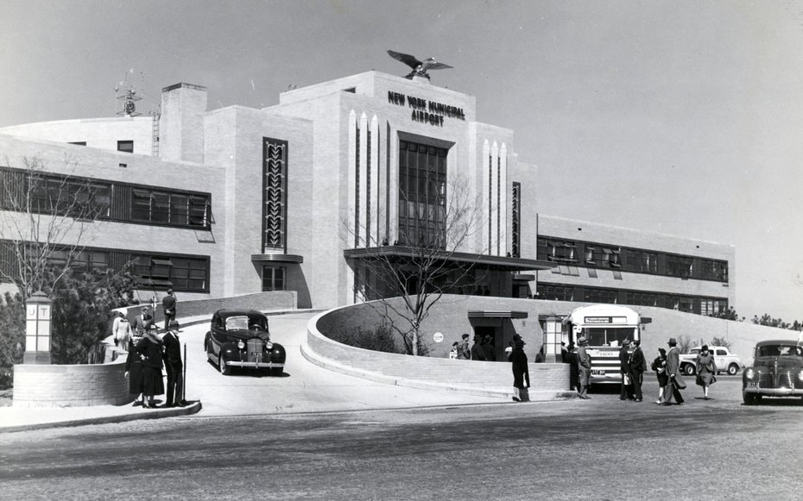
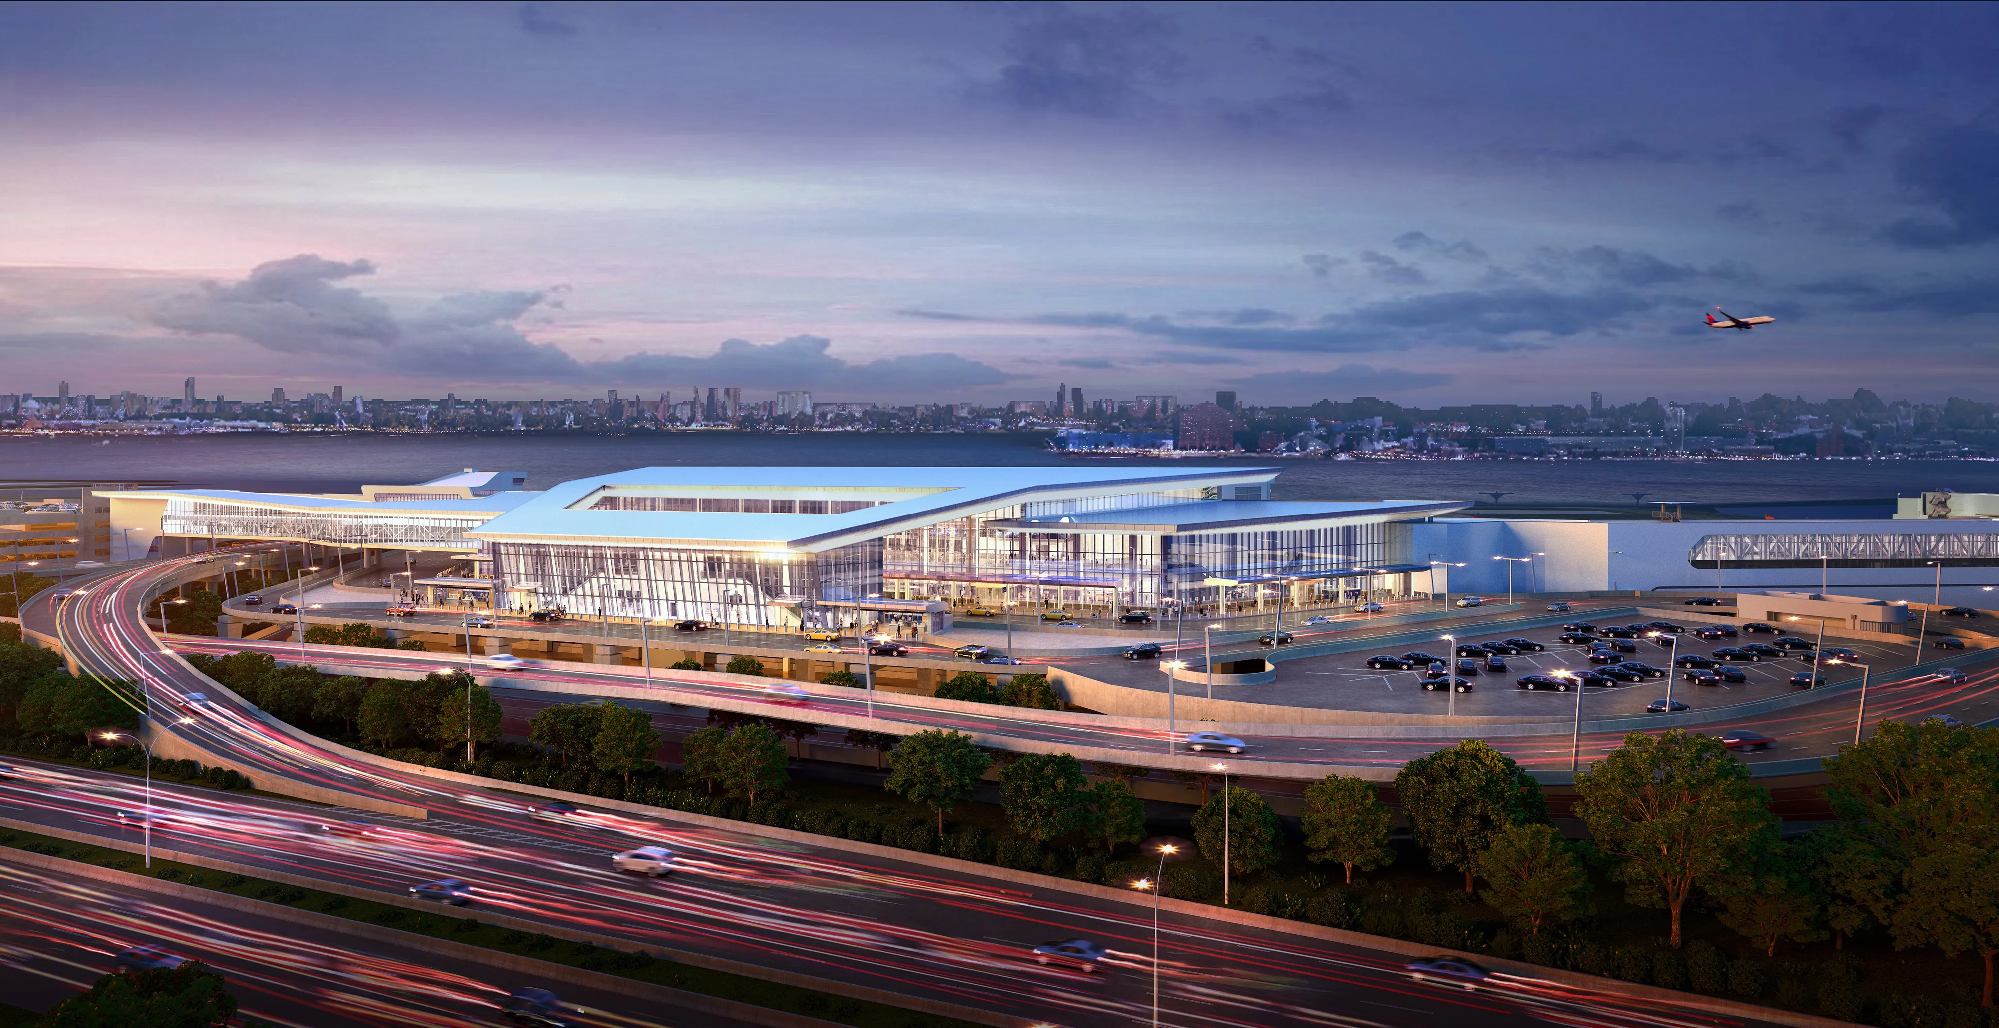
LAGUARDIA AIRPORT
Construction of New York’s LaGuardia Airport was among the largest undertakings of the WPA and included both today’s main airport (then the “landplane field”) and what is now the Marine Air Terminal (then the “seaplane division”). At the time of its completion, LaGuardia was among the most advanced airports in the world and within a year it was the busiest in the world. It now has few international flights and a bad reputation for it’s facilities.
The seaplane division was designed to accommodate regular transatlantic airplane travel whilst the landplane field was used as the eastern terminus for the planes of the Transcontinental and Western, the American, the United, and the Eastern air lines. Its facilities comprised four concrete runways and an administration building flanked by six hangars.
The WPA eventually contributed $27 million to the project. As of Spring 1939, more than 20,000 WPA relief workers worked on the project.

Slide 13
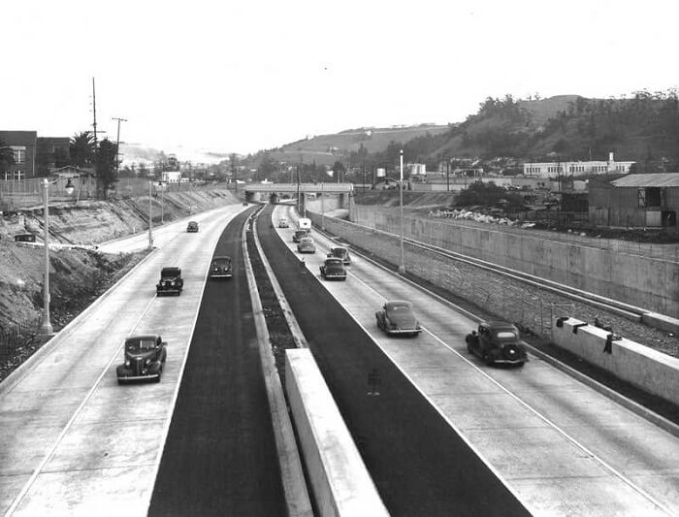
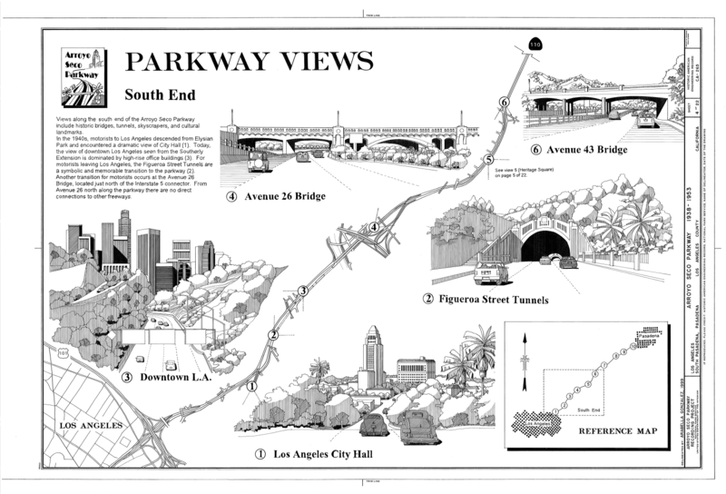
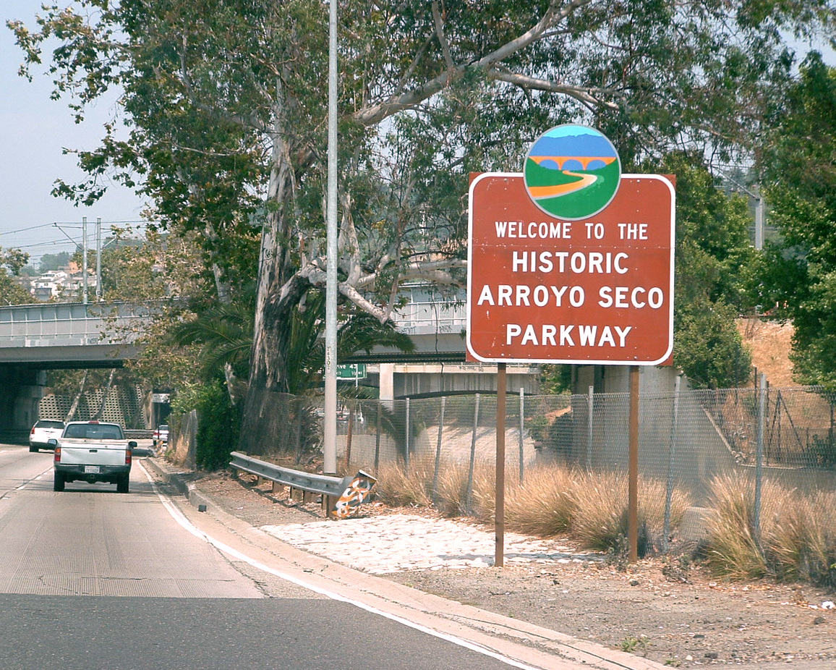
ARROYO SECO PARKWAY
This road was the first divided-lane, high-speed, limited-access road in the urban western United States and the first stretch of road for what would become the extensive Los Angeles freeway network.
The approximately six-mile initial stage of the 8.2-mile roadway, completed in 1940, was envisioned as both a scenic road traversing the Arroyo and a vital traffic conduit linking the expanding cities of Pasadena and Los Angeles. Engineers and planners attempted to blend landscaping and native plants into the overall design while implementing safety features appropriate for high-speed travel.
As road construction proceeded southward towards downtown Los Angeles in the early 1940s, the road began to more closely resemble a high-speed freeway. As a prominent example of the evolution from recreational parkways to more utilitarian high-speed freeways, the Arroyo Seco Parkway marks an important stage in the history of American transportation engineering.
Very many of the WPA projects were roads, culverts, sidewalks

Slide 14
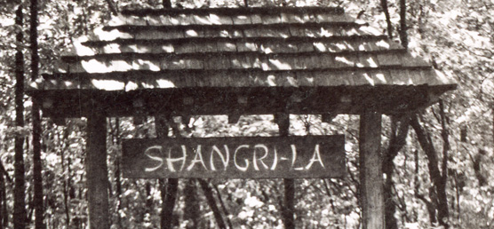
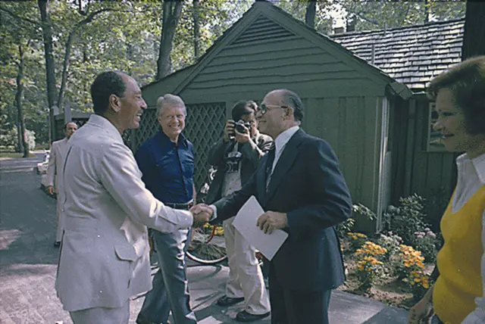
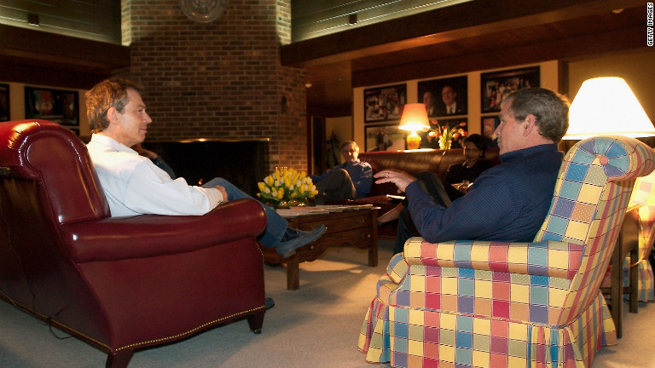
CAMP DAVID
This one came as a surprise to me and when you consider the impact of New Deal projects this one has had a worldwide impact, just a few examples:
1943 FDR hosted Winston Churchill
1959 Eisenhower met Krushchev
1978 it hosted Sadat and Begin resulting in the Camp David Peace Accords
2000’s Bush and Blair met there several times discussing the war in Iraq
2012 Obama hosted the G7 Summit
Originally known as Hi-Catoctin, Camp David was first used as a camp for crippled children followed by being used by federal government agents and their families. Construction started in 1935 and was completed in 1938. In 1942, FDR converted it to a presidential retreat and renamed it "Shangri-La“. Eisenhower renamed it Camp David after his grandson.

Slide 15
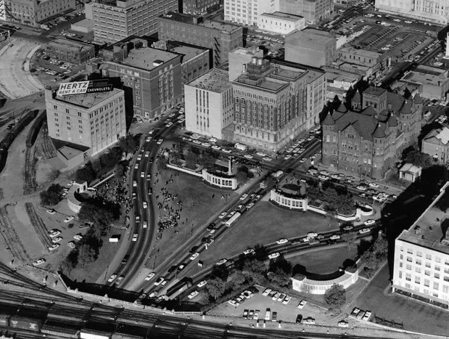
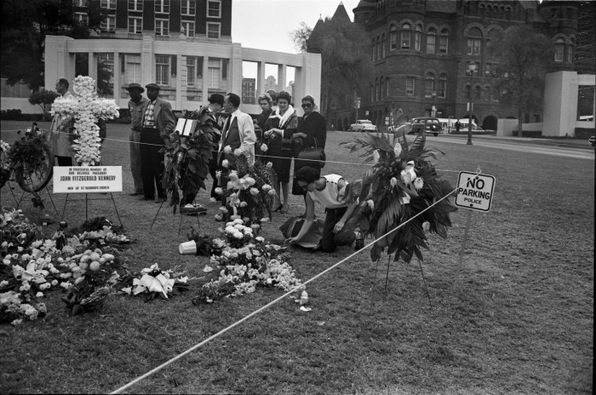
DEALEY PLACE PLAZA
The WPA undertook thousands of town and city space developments ranging from public buildings like post offices & school to town parks and urban parkways (roads).
The Dealey Plaza park project was a cooperative effort of the City of Dallas, the Texas Highway Department, and the WPA. It’s Art Deco-styled structures complemented the design details on the triple underpass. Dealey Plaza was the location of the first home built in Dallas, which also became the first courthouse and post office, the first store, and the first fraternal lodge. It is sometimes called the "birthplace of Dallas".
The plaza was completed in 1940 three streets converge to pass under a railroad bridge - the "triple underpass.“
The plaza lives in infamy as the location of President John F. Kennedy’s assassination on November 22, 1963. There may be other “grassy knolls” in American parks, but none have gone down in history like the one in Dealey Plaza.

Slide 16
African Americans and the WPA
By 1935 there were 3.5m African Americans on relief, almost 35% of that population and some 250k African American adults were working on WPA projects. During 1938 almost 45% of African American families were either on relief or employed by the WPA. This was probably double the numbers of non African Americans in the same situation.
Despite these number Civil Rights leaders claimed in many states that they were under represented but by 1941 the NAACP wrote:
It is to the eternal credit of the administrative officers of the WPA that discrimination on various projects because of race has been kept to a minimum and that in almost every community Negroes have been given a chance to participate in the work program. In the South, as might have been expected, this participation has been limited, and differential wages on the basis of race have been more or less effectively established; but in the northern communities, particularly in the urban centers, the Negro has been afforded his first real opportunity for employment in white-collar occupations.
However, the WPA operated mainly segregated units. Blacks were hired as supervisors in the North but out of 10,000 supervisors in the South only 11 were black.
(NAACP = National Association for the Advancement of Coloured People)

Slide 17
Women and the disabled and the WPA
WPA policies were consistent with the strong belief of the time that husbands and wives should not both be working (because the second person working would take one job away from some other breadwinner).
A study of 2,000 female workers in Philadelphia showed that 90% were married, but wives were reported as living with their husbands in only 18 percent of the cases. Only 2 percent of the husbands had private employment. Of the 2,000 women, all were responsible for one to five additional people in the household.
In rural Missouri, 60% of the WPA-employed women were without husbands (12% were single; 25% widowed; and 23% divorced, separated or deserted). Thus, only 40% were married and living with their husbands, but 59% of the husbands were permanently disabled, 17% were temporarily disabled, 13% were too old to work, and remaining 10% were either unemployed or handicapped. Most of the women worked with sewing projects, where they were taught to use sewing machines and made clothing and bedding, as well as supplies for hospitals, orphanages, and adoption centres.
A surprising discovery for me was the Pack Horse Library Project, this mainly employed women to deliver books to rural areas of Kentucky. Many of the women employed were the sole breadwinners for their families. My book club have just finished reading “The Giver of Stars” by Jo Moyes – all about this scheme !
The disabled were simply not employed by the WPA – well 1,500 were in New York.

Slide 18
Sources
Internet:
https://www.bechtel.com/projects/hoover-dam/
https://livingnewdeal.org/about/
https://www.history.com/news/new-deal-infrastructure-projects-fdr
https://en.wikipedia.org/wiki/New_Deal
https://en.wikipedia.org/wiki/Works_Progress_Administration
https://www.tva.com/about-tva/our-history/the-1930s
Books
These Truths – Jill Lepore
The Giver of Stars – Jo Moyes
TV - PBS America The Story of Us, Episode 9 Bust.

